Slide 1

The Intersection of the National Environmental Policy Act and the Magnuson-Stevens Fishery Conservation and Management Act
November 4, 2010
Roger Williams University Law School
Taking Stock: The Magnuson-Stevens Act Revisited

Slide 2
National Environmental Policy Act’s Interdisciplinary Approach:
“All agencies of the federal government shall—
(A) utilize a systematic, interdisciplinary approach which will insure the integrated use of the natural and social sciences and the environmental design arts in planning and decisionmaking which may have an impact on man’s environment.”
NEPA § 102; 42 U.S.C. § 4332

Slide 3
The Environmental Impact Statement – EIS
All agencies shall “include in every recommendation or report on proposals for legislation and any other major federal actions significantly affecting the quality of the human environment, a detailed statement by the responsible official on –
  the environmental impact of the proposed action,
  (ii) any adverse environmental effects which cannot be avoided should the proposal be implemented,
  (iii) Alternatives to the proposed action,
  (iv) The relationship between local short-term uses of man’s environment and the maintenance and enhancement of long-term productivity, and
  (v) Any irreversible and irretrievable commitments of resources which would be involved in the proposed action should it be implemented.

Slide 4
Additional MSA/NEPA Authorities:
NOAA Administrative Order 216-6
NMFS Operational Guidelines for the Fishery Management Process (Revised May 1, 1997)
Regional Fishery Management Councils’ Statements of Organization, Practices and Procedures (SOPPs)

Slide 5
Greenpeace v. NMFS, 55 F. Supp. 2^{d} 1248 (1999)
NEPA applies to broad management schemes developed in fishery management plans (FMPs)
NEPA does not permit NMFS to continue making “individually minor but collectively significant” changes to the FMPs without analyzing the changes.

Slide 6
Greenpeace v. NMFS (55 F. Supp 2d 1248 (1999): NEPA’s requirement that NMFS “rigorously explore and objectively evaluate all reasonable alternatives requires that the SEIS include alternatives that consider all elements of the fishery:
Location and timing of fishing
Harvestable amounts
Exploitation rates
Exploited species
Gear types and groupings
Product quality
Organic waste and secondary utlization
Discard
Species at all trophic levels
Impacts to coastal communities
Society and the economy
Fishing markets

Slide 7
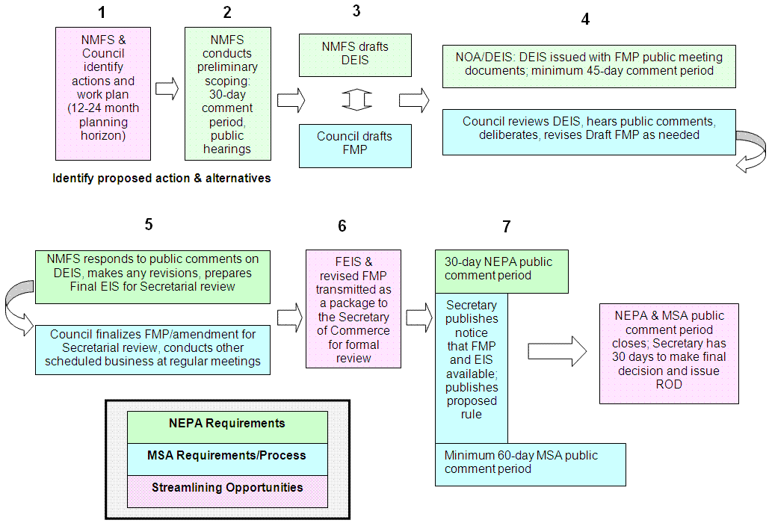
Marine Fish Conservation Network Streamlining Opportunities
Integrating NEPA Environmental Review and MSA Fishery Management Plan Development

Slide 8
Magnuson-Stevens Fishery Conservation and Management Enhancement Act, P.L. 109-479 (MSA Sec. 304(i)):
“The Secretary shall, in consultation with the Regional Fishery Management Councils and the Council on Environmental Quality, revise and update agency procedures for compliance with the National Environmental Policy Act. The Procedures shall:
  Conform to the timelines for review and approval of fishery management plans and plan amendments, and;
  Integrate applicable environmental analytical procedures, including the time frames for public input, with the procedures for the preparation and dissemination of fishery actions

Slide 9
