Slide 1
A Conservation Perspective on the Magnuson-Stevens Act
            Peter Shelley. Esq.
            Vice President
            617-850-1754
            pshelley@clf.org

Slide 2
About CLF
Founded in 1966, CLF is dedicated to solving environmental problems that threaten the people, communities and natural resources of New England.
Funded by members, foundations, earned income.
Four program areas:
  Clean Energy & Climate Change
  Ocean Conservation
  Clean Water & Healthy Forests
  Healthy Communities & Environmental Justice
Environmental consulting affiliate: CLF Ventures

Slide 3
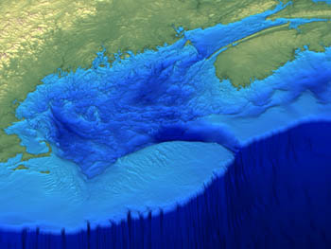
Where we work
Notes:
Where we work
Two natural resource bases in New England

Slide 4
Tragedy of the Commons
Ruin is the destination toward which all men rush, each pursuing his own best interest in a society that believes in the freedom of the commons. Freedom in a commons brings ruin to all.
      The Tragedy of the Commons, Garrett Hardin Science, 162(1968):1243-1248
“Mutual coercion, mutually agreed upon.”

Slide 5
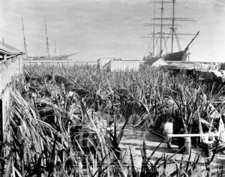
Whale Bone
Processing Yard

Slide 7
CLF challenged Amendment 4 to Groundfish FMP in 1991.
  Lessons—
    Critical importance of objective, measurable definitions of overfishing
    Need mandatory rebuilding requirements with quantified biomass goals and strict time limits
    “Overfishing” is inadequate trigger
    Stronger federal oversight of underperforming councils
    Broader public representation on councils
    Fisheries tend to over-capitalization; management tends to under-capitalization

Slide 8
Nine years later back in court with Amendment 9 of Groundfish FMP (FY 1999), which purported to implement Sustainable Fisheries Act (1996)
Judge agreed with plaintiffs on all counts: failure to stop overfishing, failure to rebuild stocks, failure to minimize bycatch. Liability ruling in 2001; remedial order in 2002.

Slide 9
Amendment 13 (FY 2004) took New England in new directions
  Adopted science biomass recommendations despite some scepticism and hesitation
  Adopted measures that ended overfishing and rebuilt all fisheries… at least on paper, although allowed “phased rebuilding,” i.e. continued overfishing, for some stocks and adopted longest time with lowest probability
  First piloting of sector management, DAS leasing and transfer

Slide 10
Amendment 13 (cont’d)
  Weak protection of EFH (later merged into Omnibus EFH Amendment)
  Weaker provisions minimizing bycatch

Slide 11
Amendment 13 (cont’d)
  Lessons—
    Fishery management needs to be embedded in more comprehensive ecosystem-based management
    Fish science must be further separated and insulated from social/economic allocation decisions
    Accountability through enforceable catch limits (overfishing still 8 years after SFA)
    Improved information systems critical to compliance and science, including expanded observers, mandatory VMS, timely data collection
    Area- and sector-based management approaches needed
    Failure to address habitat impacts potentially jeopardizing long-term productivity of system
Notes:
Prior to Kessler’s order requiring 5%, NMFS providing only 2% observer coverage
Indirect controls can work but they are too broad-brushed and promote concentration
Area-based and sector-based mgmt produce incentives, allow greater flexibility esp. important for say boats and small operations

Slide 12
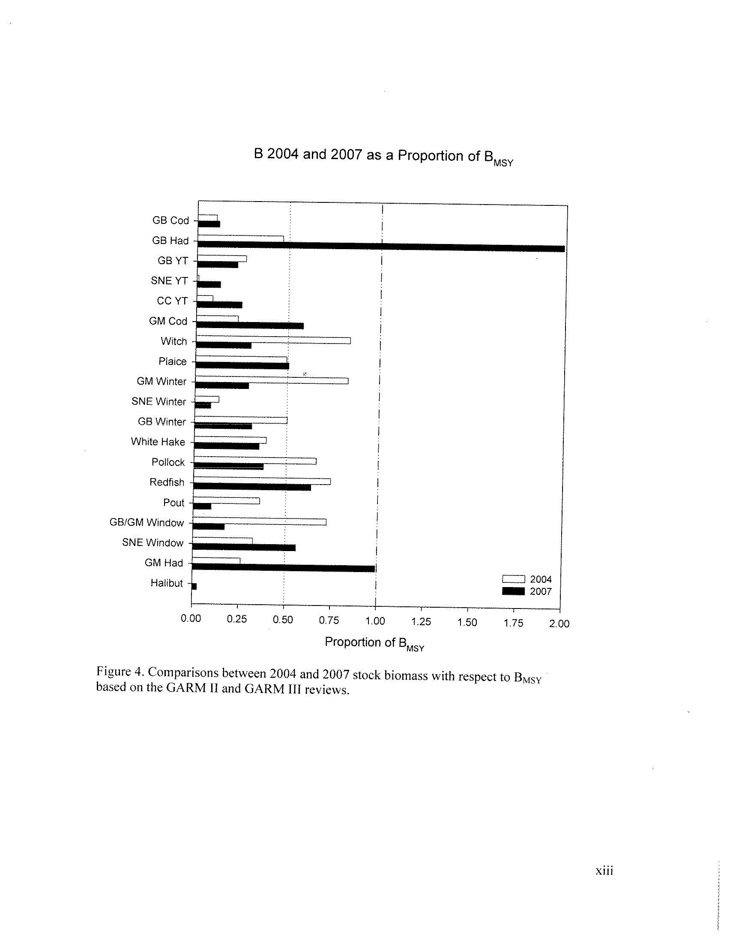

Slide 13
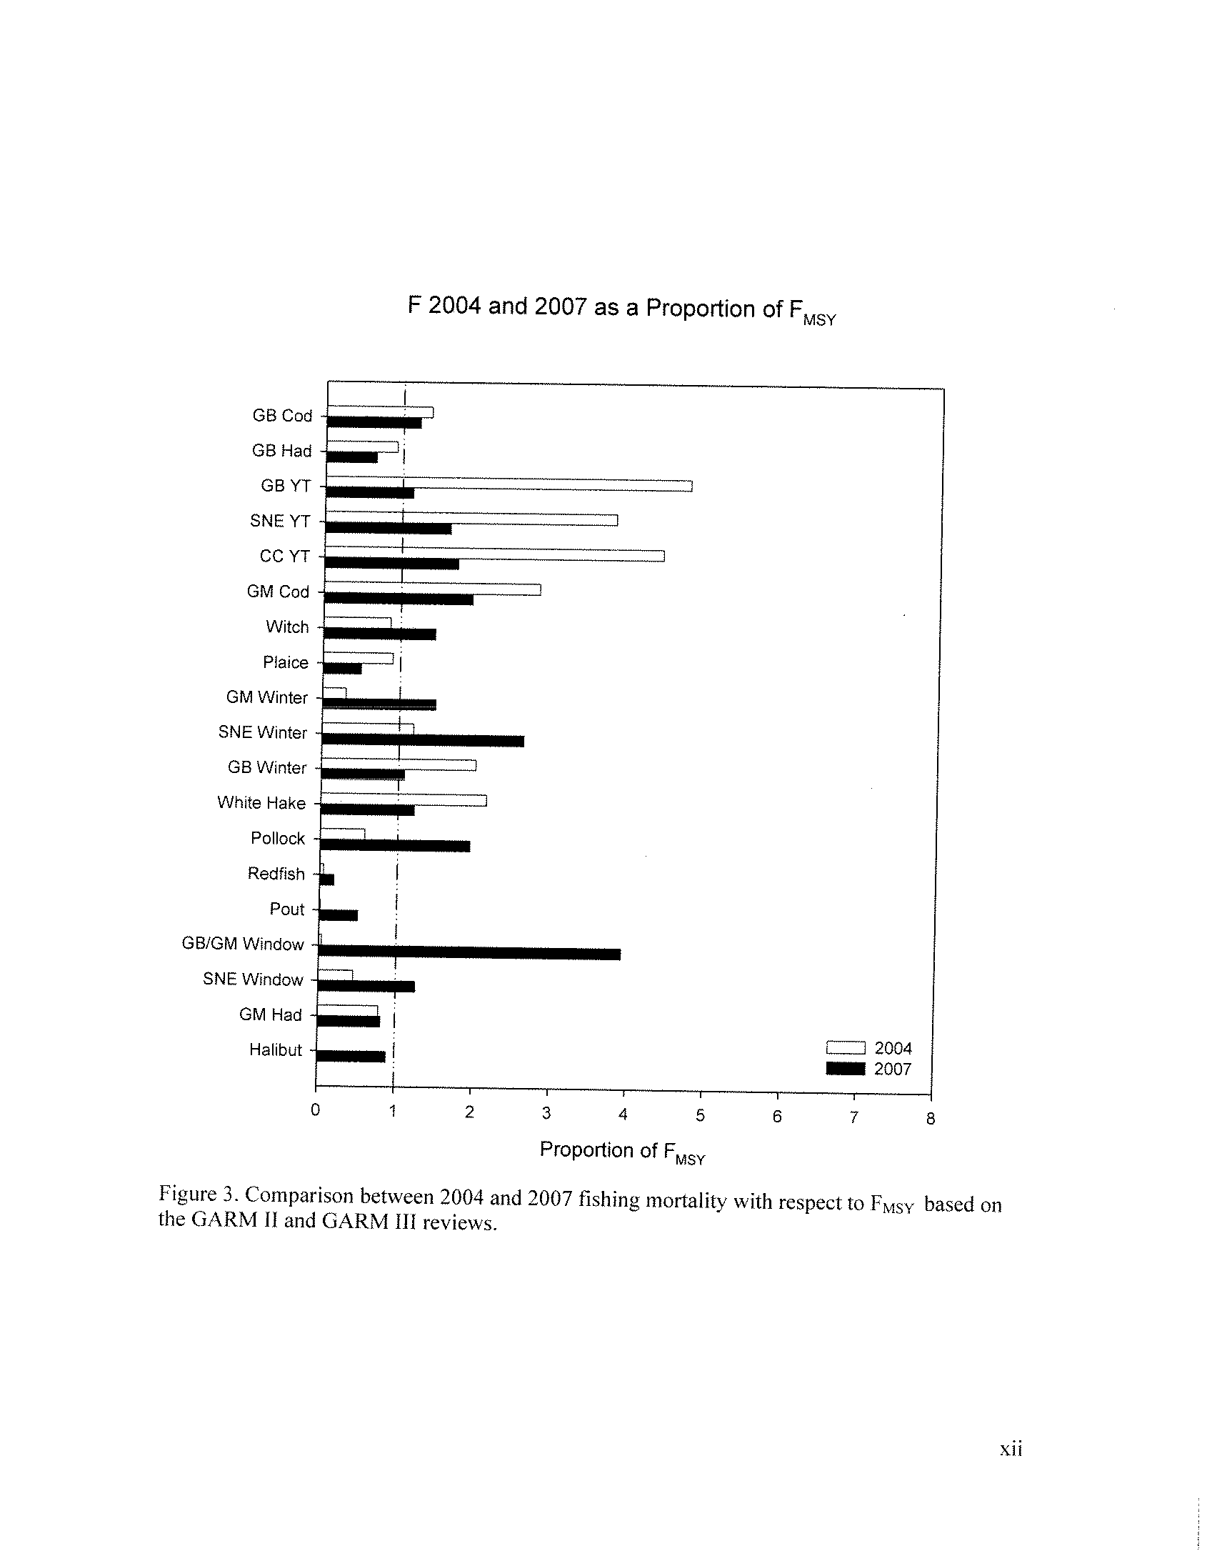

Slide 14
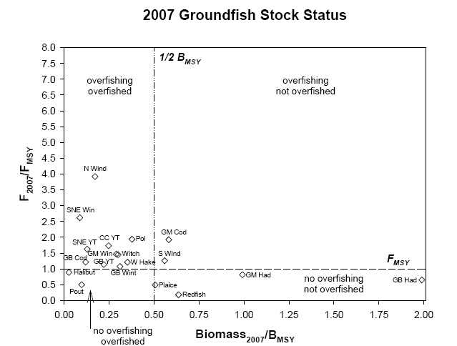

Slide 15
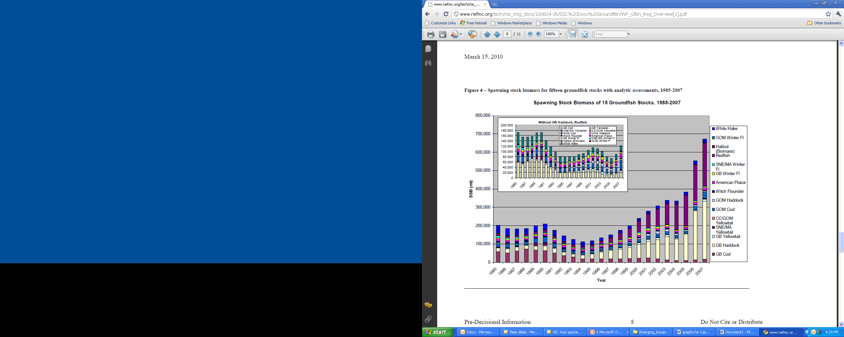

Slide 16
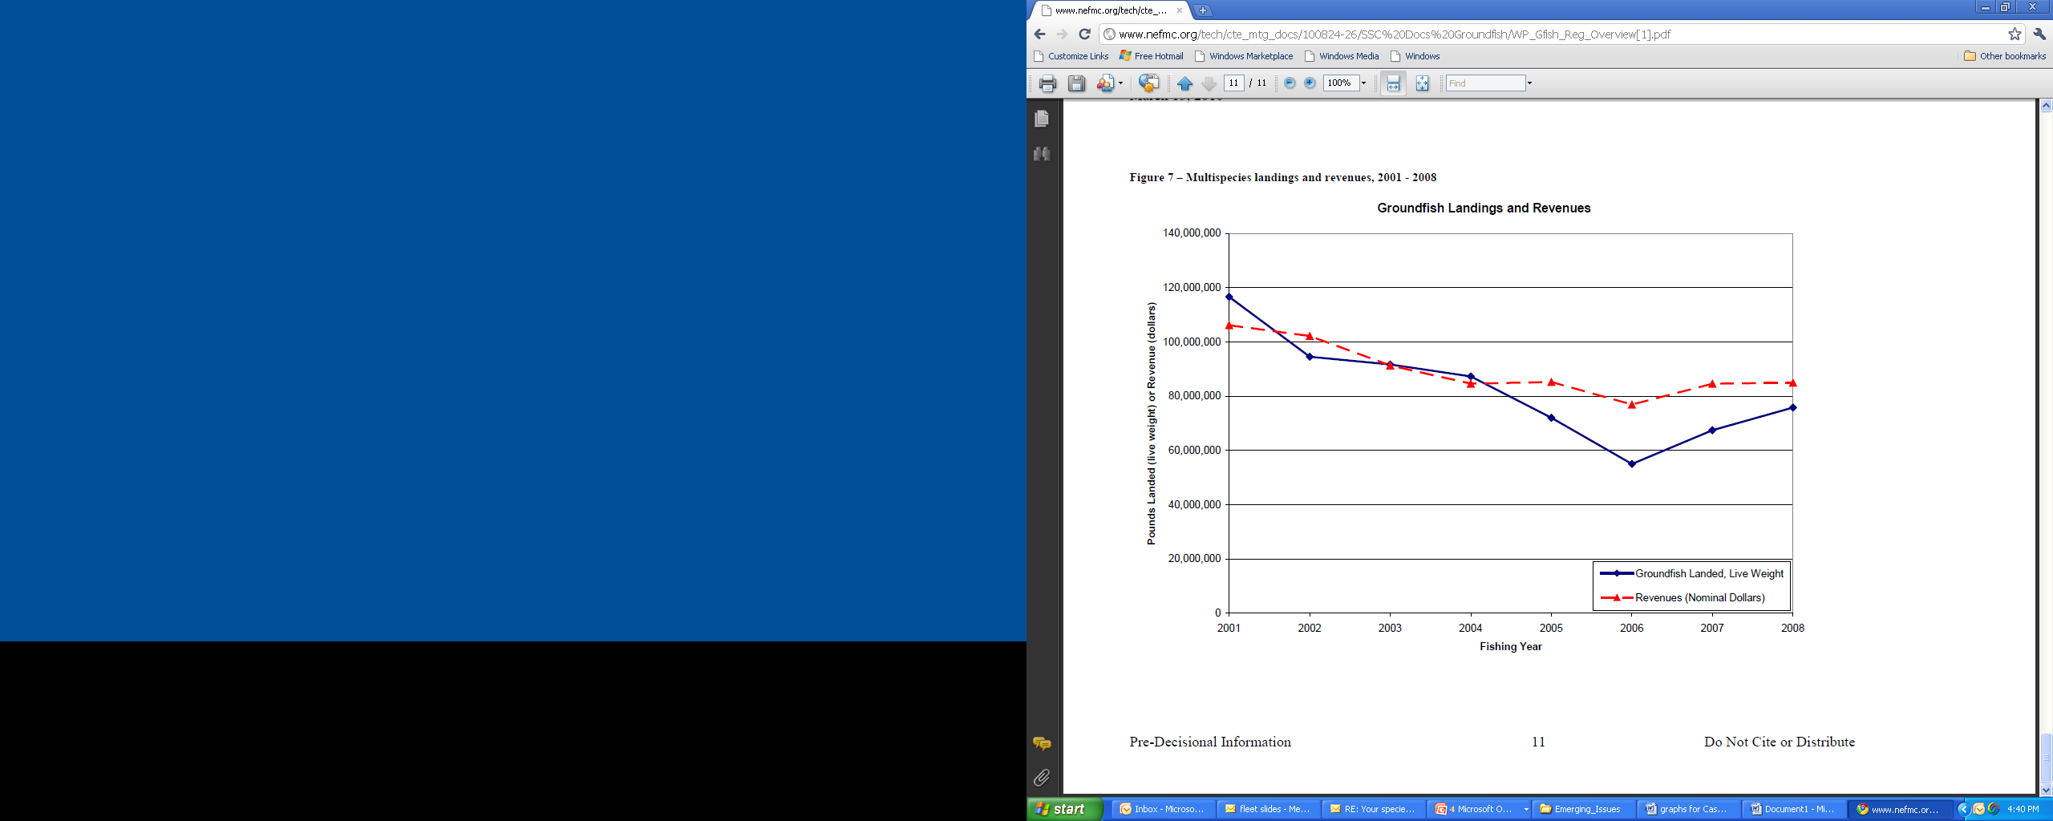

Slide 17
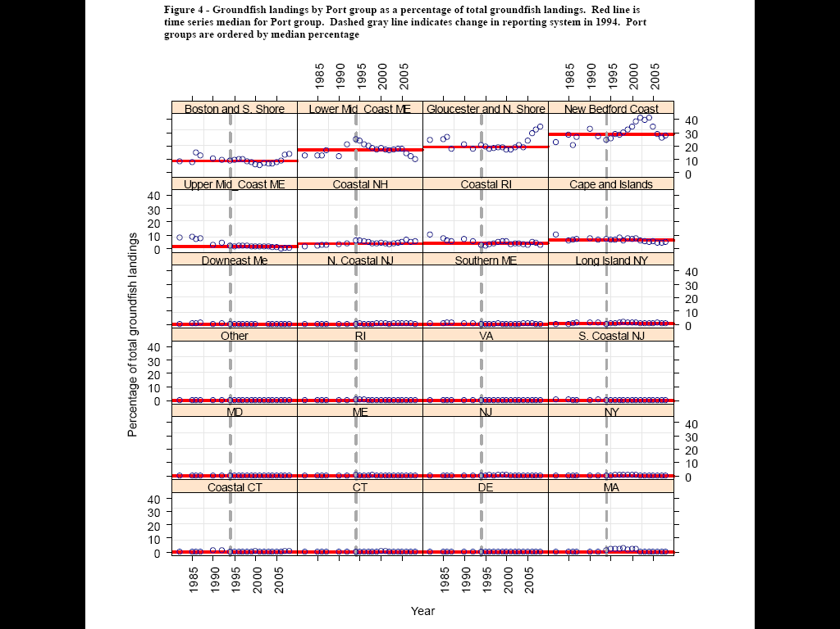

Slide 18
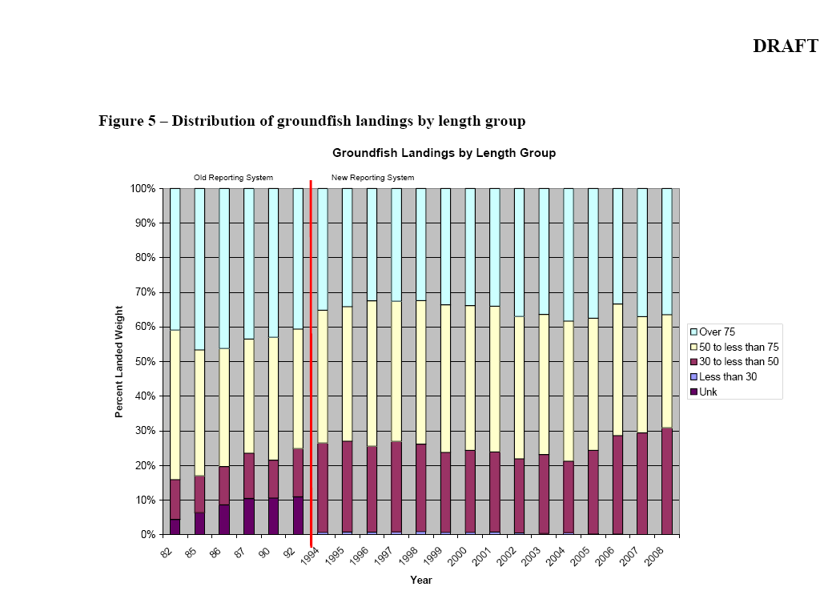

Slide 19
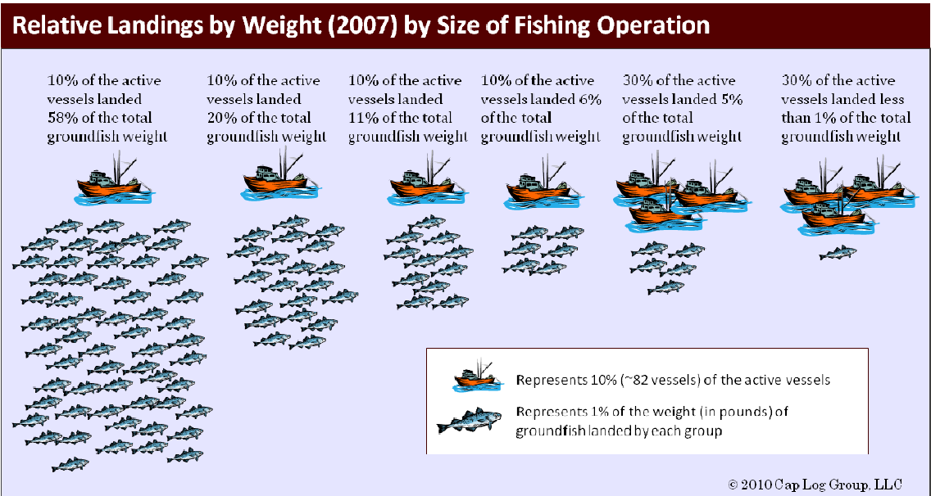
The 80-20 Rule

Slide 20
Amendment 16 (FY 2010)
  Administrative record over 50,000 pages!!
  First major FMP developed after Magnuson-Stevens Reauthorization Act of 2006
    Ends and prevents overfishing; eliminates “phased rebuilding”
    Council action must be consistent with scientific advice (new SSC created in New England)
    Accountability measures required
    New sector programs developed (non-LAPP)
    Risk tolerance still matter of council discretion

Slide 21
Amendment 16 (cont’d)
  ~95% of active groundfish fishing effort voluntarily declared into sectors
  Triggered even more lawsuits (mostly industry)
  Habitat protections still lacking although some improvements because of higher CPUEs
  Credible mortality data still at minimal levels
  Management and science still severely underfunded
  Numerous start-up challenges for sectors, although not universal

Slide 22
So, 35 years after passage of Magnuson Act, where do the fish and the fishery stand…?

Slide 24
Four-month sector landings versus sector groundfish ACLs (May 1-August 31, 2010)

Slide 25
“Frankly, if we don’t get stewardship in catch share management, we will have failed.”
        Dr. David Pierce, Ass’t. Director, MA Department of Marine Fisheries/Council member

Slide 26




For more information…
Peter Shelley
Vice President
Phone: 617-850-1404
E-mail: pshelley@clf.org

