Slide 1
Magnuson-Stevens Act – Ending Overfishing and Rebuilding the Nation’s Valuable Marine Fisheries Eric Schwaab Assistant Administrator

Slide 2
Outline
The Opportunity of Sustainable Fisheries
Magnuson Act Overview
The Regulatory Tool Box
The Council Process
Ending Overfishing and Rebuilding
Catch Shares
Strong Science
Recreational Data
Cooperative Research

Slide 3
Opportunity
Rebuilding US stocks would…
Increase the current ex-vessel value by an estimated $2.2 billion (54%) annually from $4.1 billion to $6.3 billion
Generate an estimated additional $31 billion in sales nation-wide
Generate $133 billion in sales and support 2 million jobs.

Slide 4
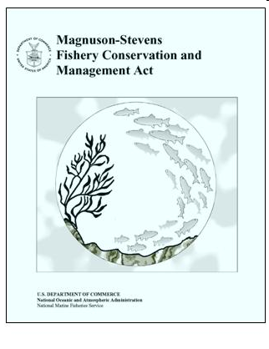
Magnuson-Stevens Act
Primary law for managing marine fisheries in Federal waters.
Enacted in 1976 and two major reauthorizations:
Sustainable Fisheries Act of 1996
Magnuson-Stevens Fishery Conservation and Management Reauthorization Act of 2006
8 regional fishery management councils charged with developing conservation and management measures.
Detailed process for fisheries management.
10 National Standards, balancing harvest levels and socioeconomic considerations.

Slide 5
Magnuson Act History
Pre Magnuson-Stevens Act (<1976)
Open access, common property, foreign fleets
1976 Magnuson Act
End foreign fishing, domestic fleet expansion, command and control management (quotas, effort, seasons, areas)
1996 Sustainable Fisheries Act
Control expansion, limit current participation
2006 Magnuson-Stevens Act Reauthorization
End overfishing, rebuild stocks, reduce overcapacity, catch shares
Implementation is underway

Slide 6
MSA: 10 National Standards
Prevent overfishing while achieving optimum yield;
Be based upon the best scientific information available;
Manage individual stocks as a unit;
Not discriminate between residents of different states;
Where practicable, promote efficiency;
Take into account variations in fisheries and catches;
Minimize costs and avoid duplications, where practicable;
Take into account the importance of fishery resources to communities;
Minimize bycatch; and
Promote safety of human life at sea

Slide 7
The 2006 Amendment
Magnuson-Stevens Fishery Conservation and Management Reauthorization Act of 2006
Signed on January 12, 2007
Mandates the use of annual catch limits and accountability measures to end overfishing
Provides for widespread market-based fishery management through limited access privilege programs
Calls for increased international cooperation
Strengthens role of science in management

Slide 8
The Regulatory Toolbox
Councils provide stakeholders a direct role in managing U.S. fisheries
Councils develop FMPs and measures based on input by their SSCs, APs, plan teams, and public comment:
Quotas, catch shares, bag limits
Allocation between groups or sectors
Seasonal or area closures
Gear restrictions
FMPs and management measures subject to approval by Commerce Secretary, acting through NOAA Fisheries

Slide 9
National Standard 1
“Conservation and management measures shall prevent overfishing while achieving, on a continuing basis, the optimum yield from each fishery for the United States fishing industry.”
MSA Section 301(a)(1)

Slide 10
Ending Overfishing and Implementing Annual Catch Limits
For a fishery that is subject to overfishing, Councils must:
Develop and implement measures that end overfishing immediately
Fishery management plans shall “establish a mechanism for specifying annual catch limits … at a level such that overfishing does not occur in the fishery, including measures to ensure accountability.”
Utilize the tools in the toolbox
Annual Catch Limits set such that overfishing doesn’t occur
Accountability Measures to keep harvest on track
May not exceed the Science and Statistical Committee’s recommendation

Slide 11
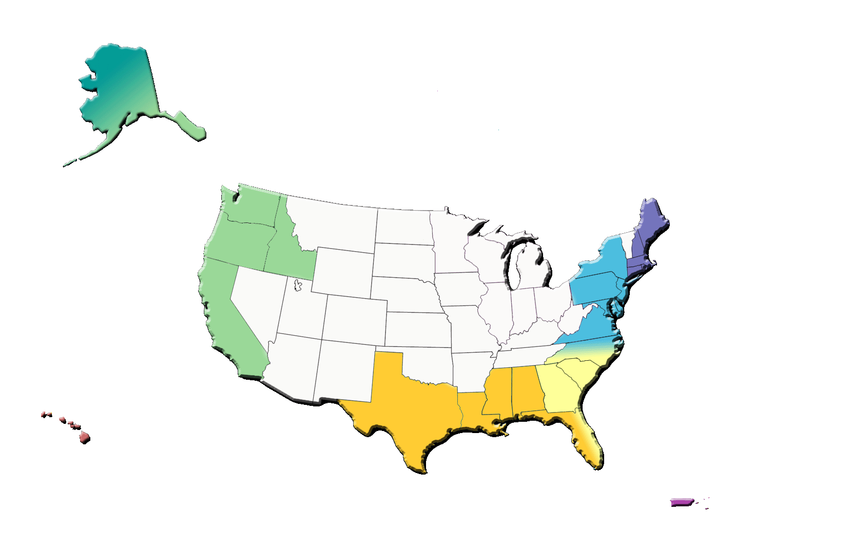
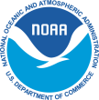
Stocks “Subject to Overfishing” (40) – as of September 30, 2010
New England:
Cod – Gulf of Maine
Cod – Georges Bank
Yellowtail flounder – Southern New England/Middle Atlantic
Yellowtail flounder – Cape Cod/Gulf of Maine
White Hake
Winter Flounder – Georges Bank
Winter Flounder – Southern New England/Middle Atlantic
Windowpane - Gulf of Maine / Georges Bank
Windowpane - Southern New England / Mid-Atlantic
Witch Flounder - Northwestern Atlantic Coast
Pacific:
Yellowfin Tuna – Eastern Pacific²
Highly Migratory
Species:
Blue Marlin – Atlantic²
White Marlin – Atlantic²
Sailfish – West Atlantic²
Albacore – North Atlantic²
Bluefin Tuna – West Atlantic²
Sandbar Shark
Dusky Shark
Blacknose Shark
Shortfin Mako - Atlantic
Pacific and Western Pacific
Bigeye Tuna – Pacific²
Pacific bluefin tuna – Pacific²
South Atlantic:
Vermilion Snapper 2. Red Snapper
3. Snowy Grouper 4. Tilefish
5. Red Grouper 6. Black Sea Bass
7. Gag 8. Speckled Hind
9. Warsaw Grouper
Gulf of Mexico:
Red Snapper
Greater Amberjack
Gag
Gray Triggerfish
Caribbean:
Snapper Unit 1
Grouper Unit 1
Grouper Unit 4
Queen Conch
Parrotfishes¹
U.S. Department of Commerce
National Oceanic and Atmospheric Administration
National Marine Fisheries Service
Office of Sustainable Fisheries
1. Indicates non-FSSI stock
2. Stock is fished by U.S. and International fleets.
Blue = Also Overfished

Slide 12
Rebuilding Overfished Stocks
For a fishery determined to be overfished, Councils must:
Develop and implement measures within 2 years that begin rebuilding
Set a rebuilding time that is
as short as possible taking into account several factors
does not exceed 10 years, except where biology, environmental conditions, or international agreements dictate otherwise

Slide 13
Overfished Stocks (47) – as of September 30, 2010
New England:
Atlantic Cod – Georges Bank
Yellowtail Flounder – Georges Bank
Yellowtail Flounder – Southern New England/Middle Atlantic
Yellowtail Flounder – Cape Cod/Gulf of Maine
White Hake
Winter Flounder - Southern New England / Mid-Atlantic
Ocean Pout
Atlantic Halibut
Windowpane - Gulf of Maine / Georges Bank
Winter flounder - Georges Bank
Witch flounder - Northwestern Atlantic Coast
Smooth Skate 14. Thorny Skate
13. Atlantic Salmon¹ 15. Atlantic Wolffish - Gulf of Maine /
Georges Bank¹
North Pacific:
Blue King Crab – Pribilof Islands
Highly Migratory
Species:
Blue Marlin – Atlantic²
White Marlin – Atlantic²
Albacore – North Atlantic²
Bluefin Tuna – West Atlantic²
Sandbar Shark
Porbeagle Shark
Dusky Shark
Blacknose Shark
Pacific:
1. Cowcod
Yelloweye Rockfish
Canary rockfish - Pacific Coast
Petrale sole – Pacific Coast
Coho salmon - Washington Coast:
Queets¹
6. Coho salmon - Washington Coast:
Western Strait of Juan de Fuca¹
7. Chinook salmon - California Central Valley: Sacramento (fall)¹
Mid-Atlantic:
Butterfish (Atlantic)
South Atlantic:
Pink Shrimp
Snowy Grouper
Black Sea Bass
Red Porgy
Red Snapper
Red Grouper
Western Pacific
Seamount Groundfish Complex – Hancock Seamount
Gulf of Mexico:
Red Snapper
Greater Amberjack
Gray Triggerfish
Gag
Caribbean:
Grouper Unit 1
Grouper Unit 2
Grouper Unit 4
Queen Conch
U.S. Department of Commerce
National Oceanic and Atmospheric Administration
National Marine Fisheries Service
Office of Sustainable Fisheries
1. Indicates non-FSSI stock
2. Stock is fished by U.S. and International fleets.

Slide 14
Measuring Progress
21 stocks rebuilt since 2000
The Fish Stock Sustainability Index – measure increasing understanding of primary stocks and management success

Slide 15
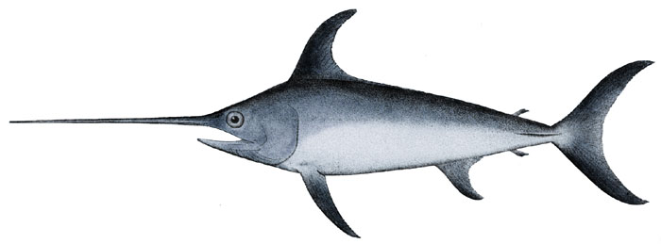
Rebuilding Success

Slide 16
Catch Shares
Catch share is a term used to describe fishery management programs that allocate a specific portion of the total allowable catch to individuals, cooperatives, communities, or other eligible entities.
The recipient of a catch share is directly accountable to stop fishing when its exclusive share or allocation is reached.

Slide 17
Final Catch Share Policy Statement
To achieve long-term ecological and economic sustainability of the Nation’s fishery resources and fishing communities:
NOAA encourages the consideration and adoption of catch shares wherever appropriate in fishery management and ecosystem plans and amendments, and will support the design, implementation, and monitoring of catch share programs.

Slide 18
Northeast Groundfish Catch - 2010

Slide 19
Northeast Groundfish Sectors - Preliminary Results

Slide 20
Northeast Groundfish Sectors - Preliminary Common Pool Results

Slide 21
Science-based Decision-Making and Peer Review
Peer review included in all stock assessments for federally managed stocks
Functional science and statistical committees (SSC) in all councils
Recommend science-based acceptable biological catches to the councils
Provide information on scientific & management uncertainty to the councils
Council/SSC control rules
Risk assessment
Likelihood catch will exceed the acceptable biological catch or ACL

Slide 22
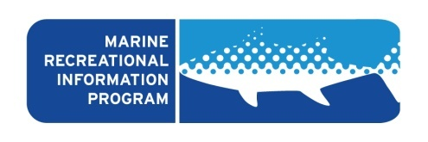
Marine Recreational Information Program
The Magnuson-Stevens Reauthorization Act called for more accurate and precise recreational fishing information
Goals include:
Improve the quality of catch and effort surveys.
Create a national registry of saltwater anglers.
Implement technical recommendations related to survey design and data collection.
Improve the for-hire survey
Evaluation of whether estimation procedures
appropriately match sample designs
www.CountMyFish.noaa.gov

Slide 23
Cooperative Research
Involve commercial and recreational fishermen in the collection of information to support the development and evaluation of management options
Benefits:
Collection of more and better data at lower cost
Improved access to vessels and time at sea
Increase the precision and expand the scope of fisheries resource surveys
Build mutual understanding and respect among participants

Slide 24
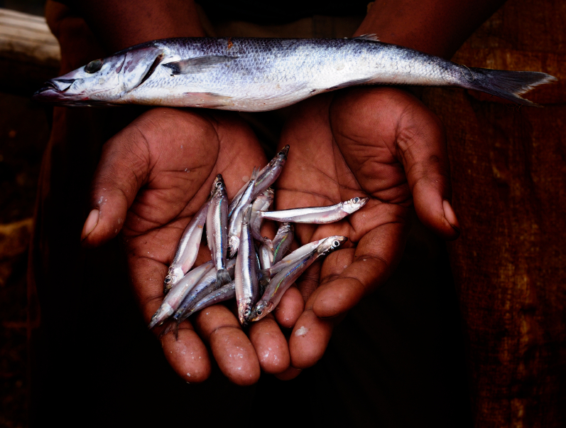
Questions?

