Slide 1
National Ocean Policy Eric Schwaab Assistant Administrator for Fisheries
A National Policy for the Stewardship of the Oceans, Our Coasts and the Great Lakes –
Established by Presidential Executive Order on July 19, 2010

Slide 2
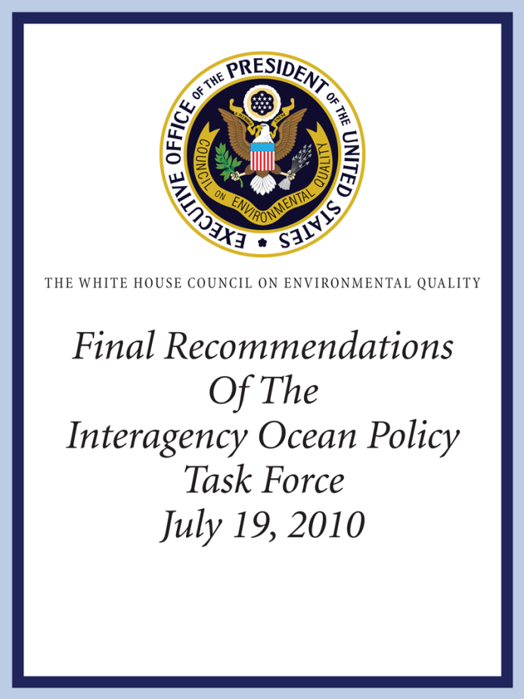
Building Blocks
National Ocean Policy
National Ocean Council
9 National Priority Objectives
Framework for Coastal and Marine Spatial Planning (CMSP)
Regional Planning Bodies

Slide 3
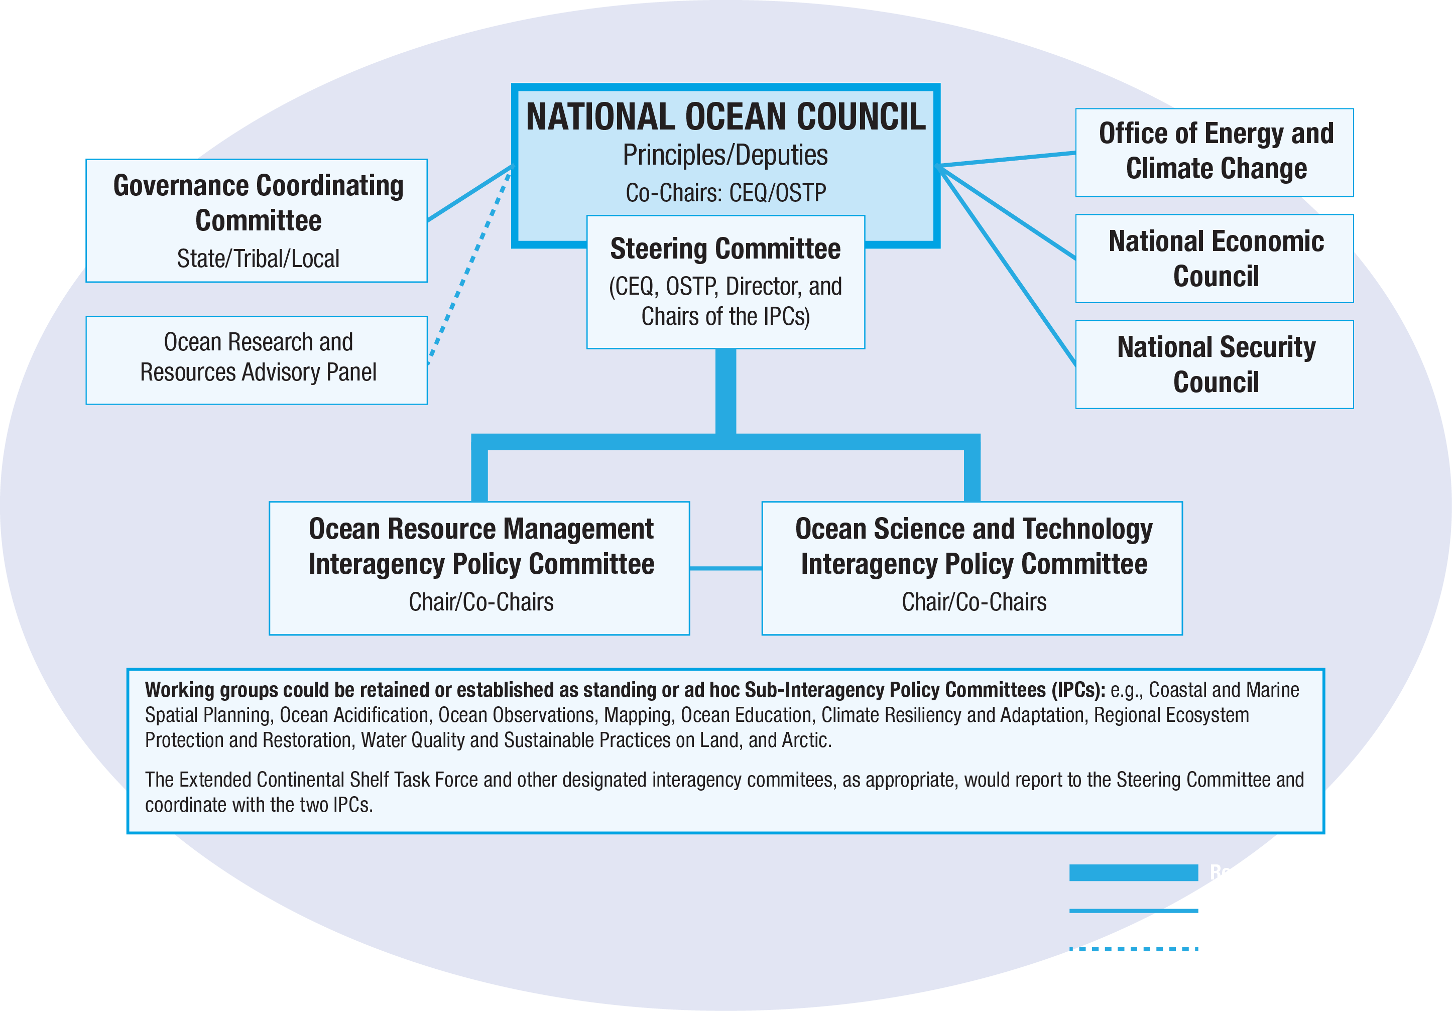
The National Ocean Council

Slide 4
National Ocean Policy Nine Priority Objectives & NOAA’s Draft NGSP
HOW WE DO BUSINESS
3 OF NOAA’S NEXT GENERATION STRATEGIC PLAN GOALS ARE ALIGNED WITH NOP
AREAS OF SPECIAL EMPHASIS
Resiliency & Adaptation to Climate Change & Ocean Acidification
Ecosystem-Based Management
1.
Climate Adaptation & Mitigation
Regional Ecosystem Protection & Restoration
Coastal & Marine Spatial Planning
2.
Water Quality & Sustainable Practices on Land
Inform Decisions & Improve Understanding
Healthy Oceans
Changing Conditions in the Arctic
3.
Coordinate & Support
Resilient Coastal Communities
Ocean, Coastal, & Great Lakes Observation, Mapping & Infrastructure

Slide 5
The Need for CMSP
Uses were regulated on a narrow sector-by-sector basis
SCIENCE
COMMERCIAL FISHING
AQUACULTURE
CONSERVATION
RECREATION
NAVIGATION
ENERGY & INDUSTRY

Slide 6
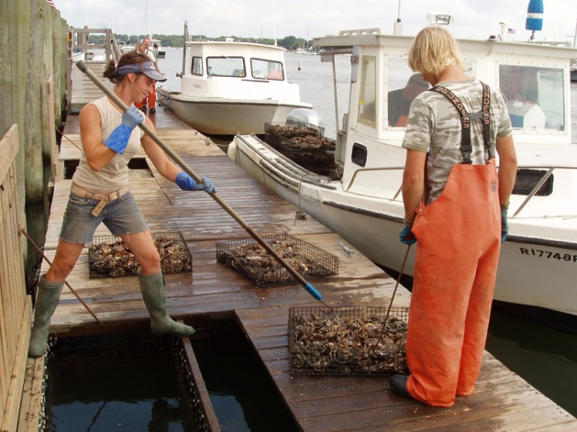
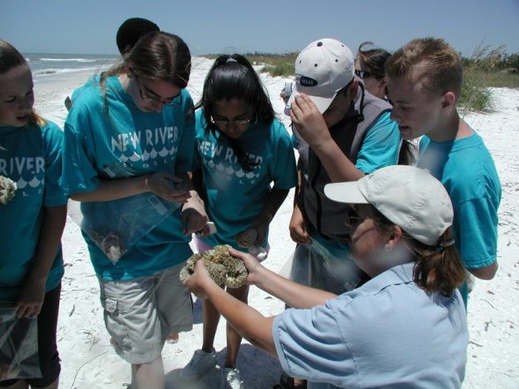
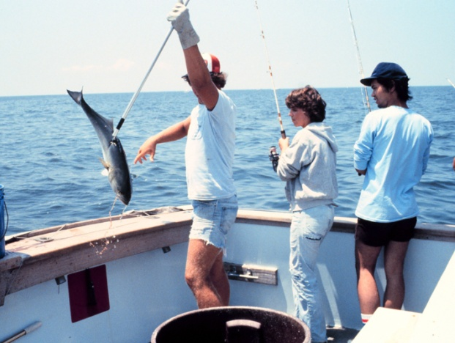
CMSP FRAMEWORK Key Elements
Balance Ocean Health and Community Prosperity
Level the Playing Field for All Stakeholders
Make Decisions Based on the Best Available Science
Respect the Unique Character of Each U.S. Region

Slide 7
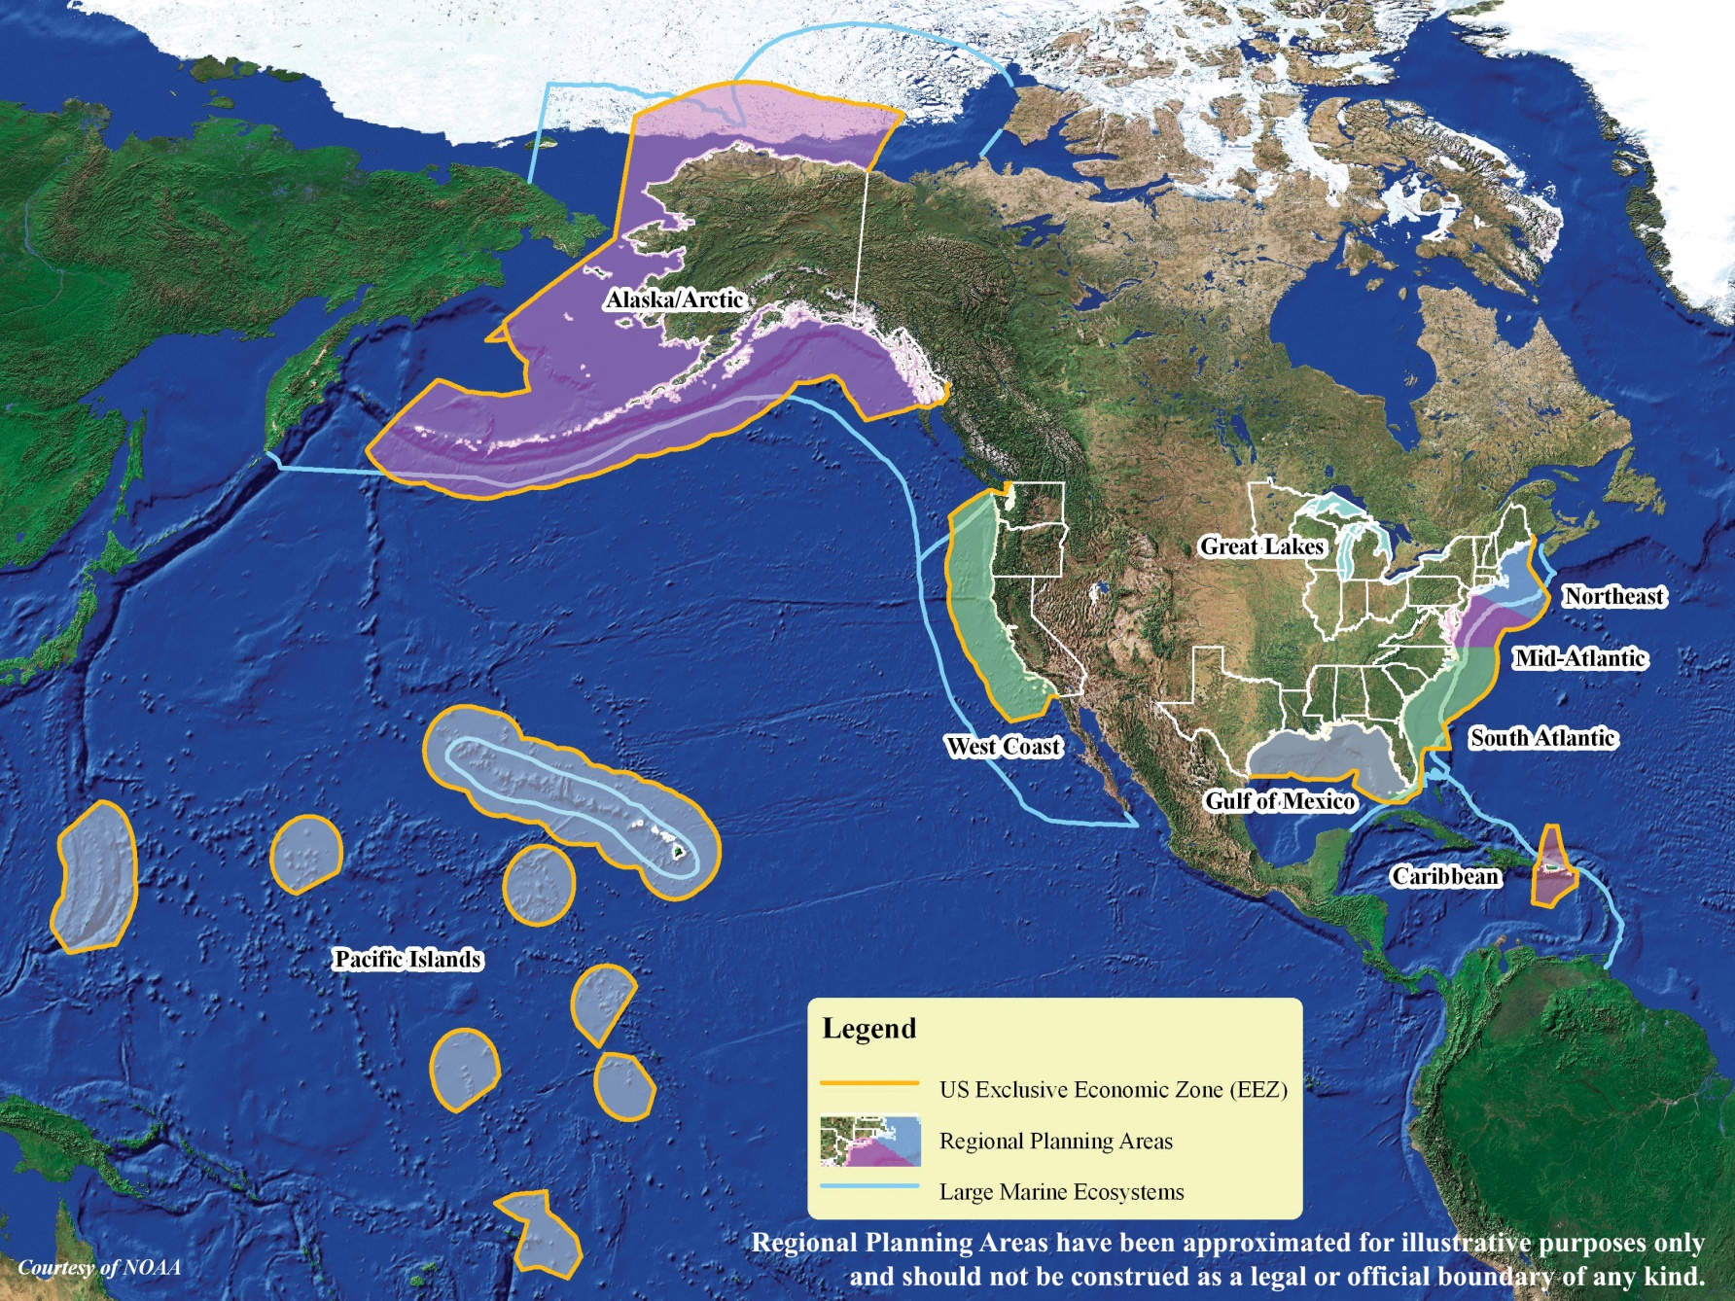
CMSP Implementation Regional Focus

Slide 8
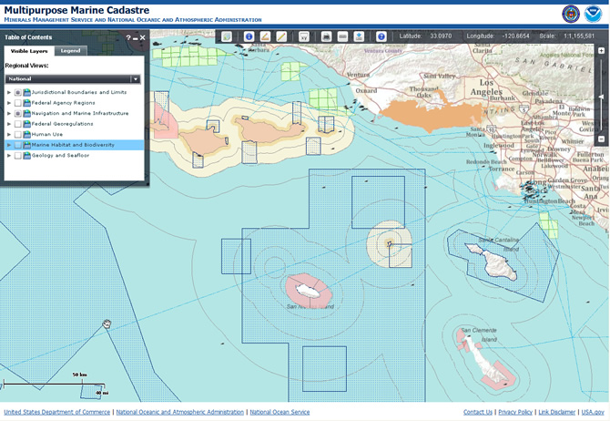
CMSP Implementation Science, Research & Data Integration
Science-based decision making
Identification of priority research needs
Establishment of a National information management system with a central or regional portals to connect CMSP information
Nationally consistent derived data products for regional assessments

Slide 9
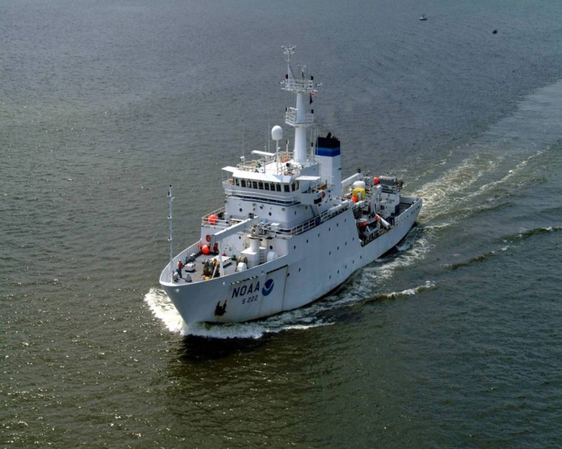
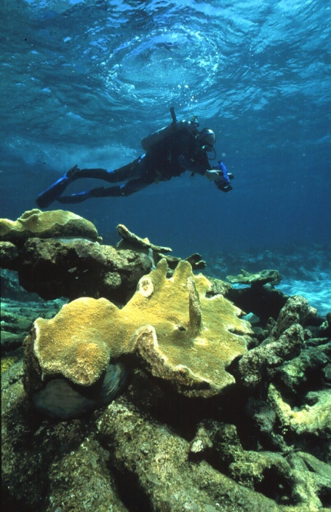
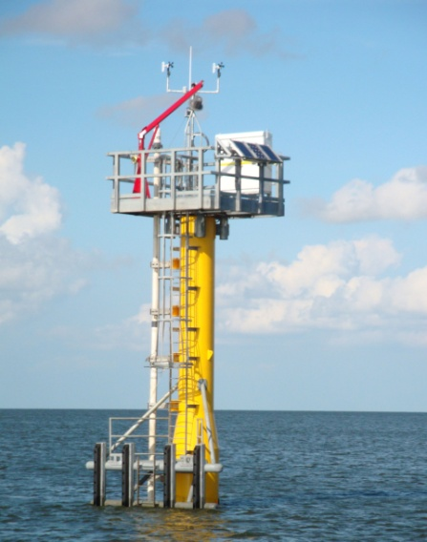
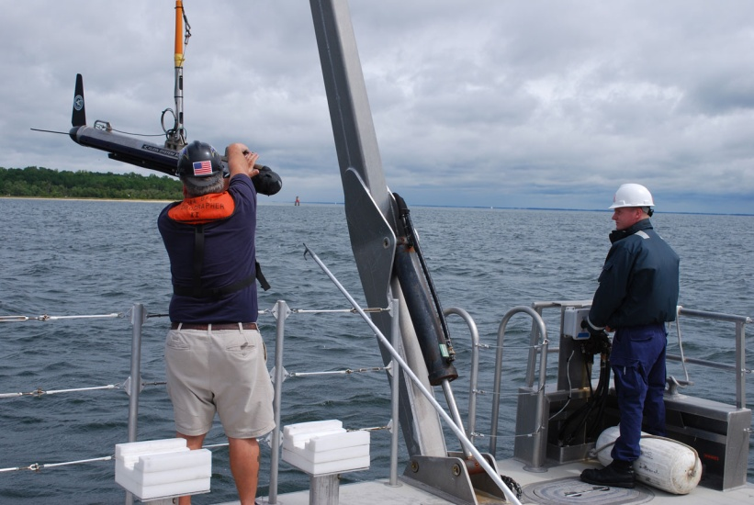
CMSP Implementation NOAA’s Role
Legal authorities and scientific expertise
Participate on all 9 Regional Planning Bodies
FY 11 Budget Request
$20M Regional Ocean Partnership Grants
$6.77M for capability to support CMSP
NOAA CMSP Program

Slide 10
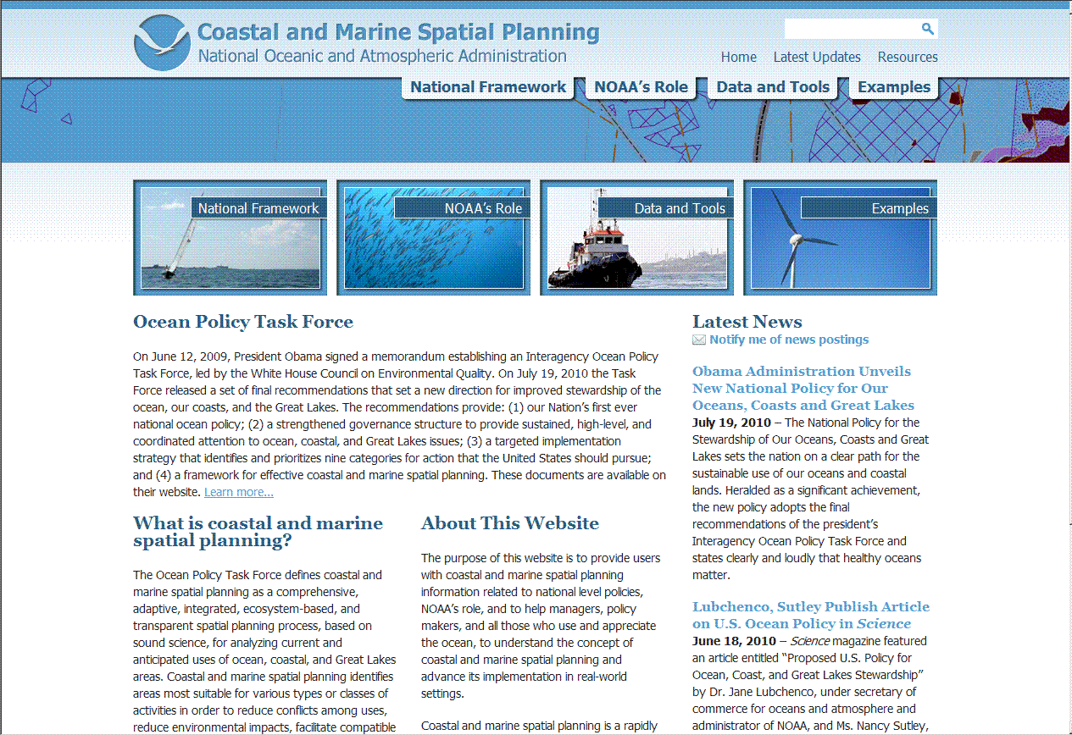
NOAA’s CMSP Website cmsp.noaa.gov

Slide 11
Role of Fishery Management Councils
Regional Fisheries Management Councils will play an important role in Regional CMSP
Experience —bringing their expertise from decades of involvement in the science- and ecosystem-based management of fisheries.
Science — providing research on fisheries biology and a wealth of economic data to support management goals.
Constituents — representing commercial and recreational fishing interests.
Management responsibilities — have authority to develop management and protection measures for fisheries, habitat, and deep-sea corals

Slide 12
Commercial and Recreational Fishing Community
Commercial and recreational fishery interests will have the opportunity to engage in CMSP in two ways through:
Regional Fishery Management Council consultations with RPBs
RPB Stakeholder Engagement Processes

Slide 13
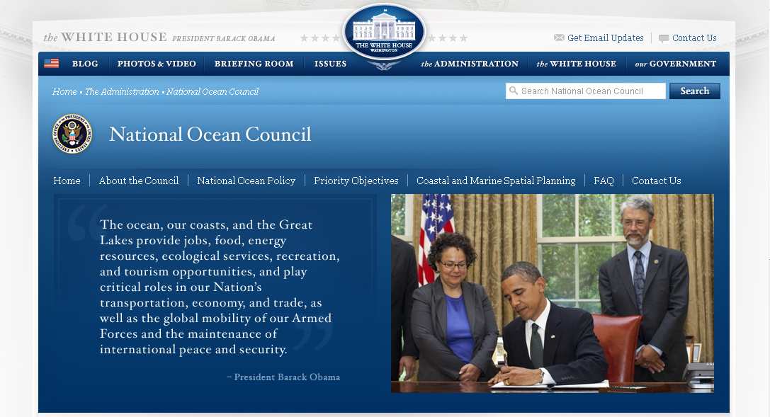
National Ocean Council Website whitehouse.gov/oceans

Slide 14
Questions?

