Slide 1
Uniting Resource Management
with Spatial Planning
by Morgan Gopnik
November 4, 2010
Roger Williams University Marine Law Symposium
“Taking Stock: The Magnuson-Stevens Act Revisited”
Pub. L. 106- 513, 16 U.S.C. § 1431 Fed. Reg. 66875

Slide 2
Marine Spatial Planning in the U.S.
2005 2006 2007 2008 2009 2010 2011
Expert meeting, DC
Mass. Oceans Act
RI Ocean SAMP plan
Mass. Ocean Plan
1st MSP Conference, Paris
RI Ocean SAMP begins
1st Moore Fdn. grant to MOP
Ocean Task Force created
OTF recs adopted in EO

Slide 3
Resources are part of Ecosystems
Oceans
are similar to
Public lands

Slide 4
Evolution of Forest Management Policy
Goals
exploitation (1897 on)
 multiple-use and sustained yield (1960)
 planning (1976)
Process
top-down management (early 1900s)
 formal public input -- plus litigation and media wars (‘70s – ’80s)
 collaboration (‘90s – present)

Slide 5
Lessons from the land
Resources only exist as part of ecosystems
Scientific knowledge ≠ policy judgment
Meaningful public participation matters
Proactive spatial planning is necessary (but not easy!)

Slide 6
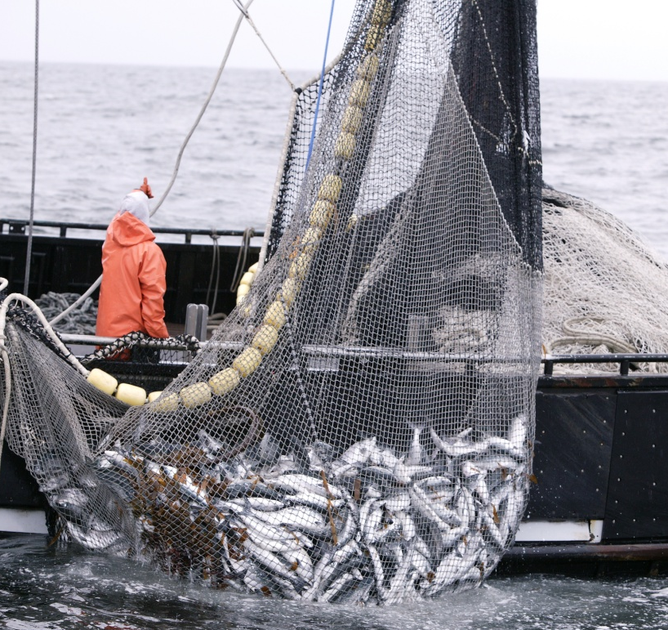
Take-away: Place fisheries management within a broader ecosystem context through proactive spatial planning

