Slide 1

MSP AND THE FISHERY
Notes:
1

Slide 2
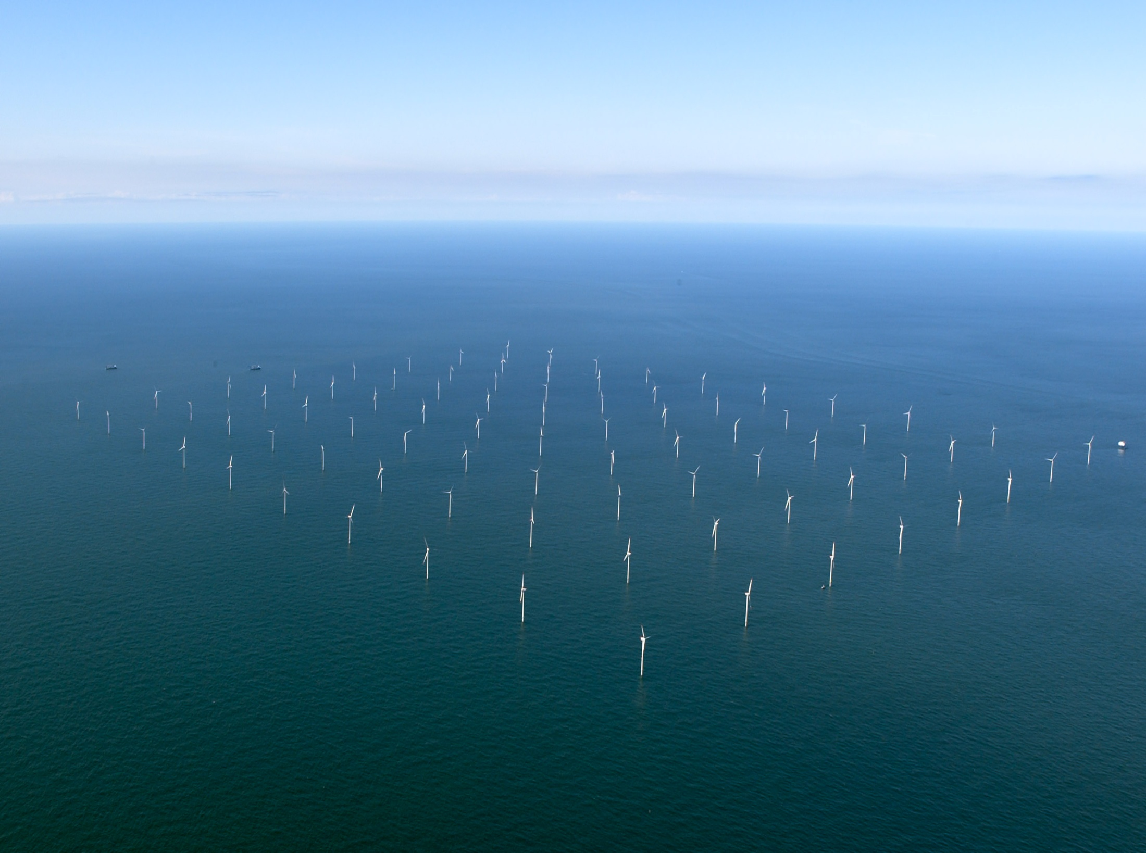
The Issue
New Uses Are Increasing
A Major Player is Offshore Energy
Horns Rev
Country: Denmark Location: West Coast Total Capacity: 160 MW Number of Turbines: 80 Distance to Shore: 14-20 km Depth: 6-12 m Capital Costs: 270 million Euro Manufacturer: Vestas Total Capacity: 2 MW Turbine-type: V80 - 80m diameter
Hub-height: 70-m Mean Windspeed: 9.7 m/s Annual Energy output: 600 GWh
Notes:
2
Horns rev
7D spacing – 8 x 10 array
V-80 machines

Slide 3
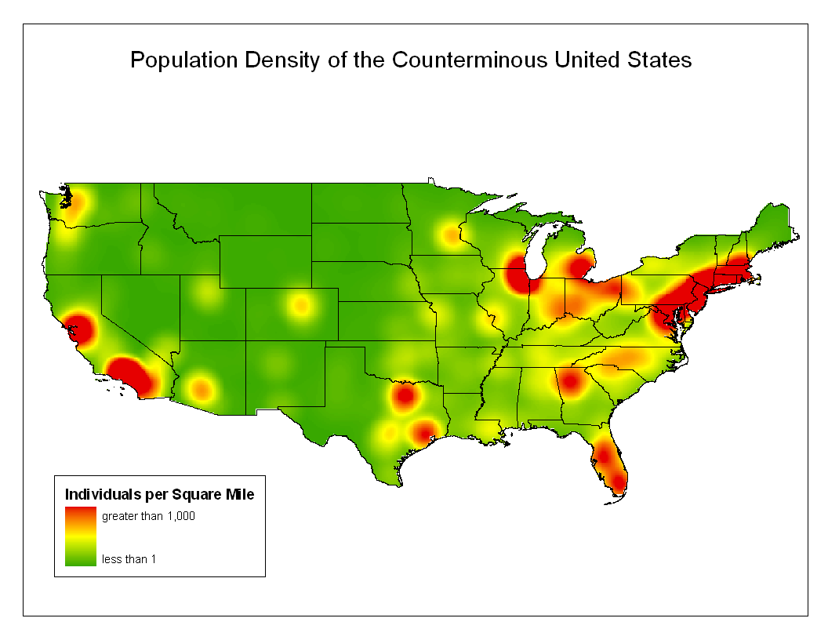
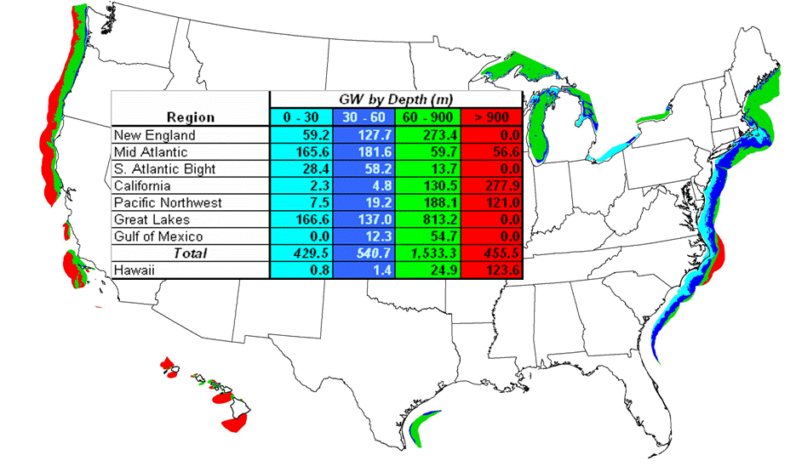
Why Offshore Wind?
28 coastal states use 78% of the electricity in US
Coastal load centers are transmission constrained and cannot be easily served by land-based wind.
Wind energy goals cannot be achieved without offshore contributions
US Population Concentration
U.S. Wind Resource and Bathymetry
Graphic Credit: Bruce Bailey AWS Truewind
Notes:
3

Slide 4
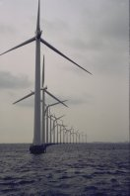
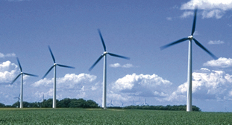
Vision: 20% Wind by 2030
(54,000 MW from Offshore)
2009
http://www1.eere.energy.gov/windandhydro/pdfs/41869.pdf

Slide 5
US Offshore Wind Initiatives
Project | State | MW
Capewind | MA | 468
Hull Municipal | MA | 15
Buzzards Bay | MA | 300
Rhode Island (OER) | RI | 400
Winergy | NY | 12
New Jersey (BPU) | NJ | 350
Delmarva | DE | 350
Southern Company | GA | 10
W.E.S.T. | TX | 150
Cuyahoga County | OH | 20
Total MW |  | 2075
US Offshore Wind Commercial Projects
Hull Municipal
Buzzards Bay
Cape Wind Associates
Rhode Island
New Jersey
Cuyahoga County
Delaware
No Offshore Wind Projects Installed In North America Yet
Atlantic Ocean
Southern Company
W.E.S.T. LLC
Project in Federal Waters
Project in State Waters
Gulf of Mexico
Notes:
5
Outlook for US offshore projects is very good
Most projects have are progressing and are awaiting maturity of the regulatory rules and the availability of wind turbine partners willing to manufacture offshore machines for the US market.

Slide 6

The project, dubbed the Atlantic Wind Connection, calls for spending as much as $5 billion to create a 350-mile network of underwater cables stretching from northern New Jersey to Virginia. It would eliminate the need for offshore wind developers to build transmission lines of their own, easing what can be a barrier for such projects.

Slide 7
Current Installed Offshore Capacity (Country, MW Installed at the end of 2008)
1,471.25-MW
http://www.ewea.org/index.php?id=203
Notes:
7

Slide 8
Projects Planned by 2015 Europe and North America
40,616-MW
http://www.ewea.org/index.php?id=203
Notes:
8

Slide 9
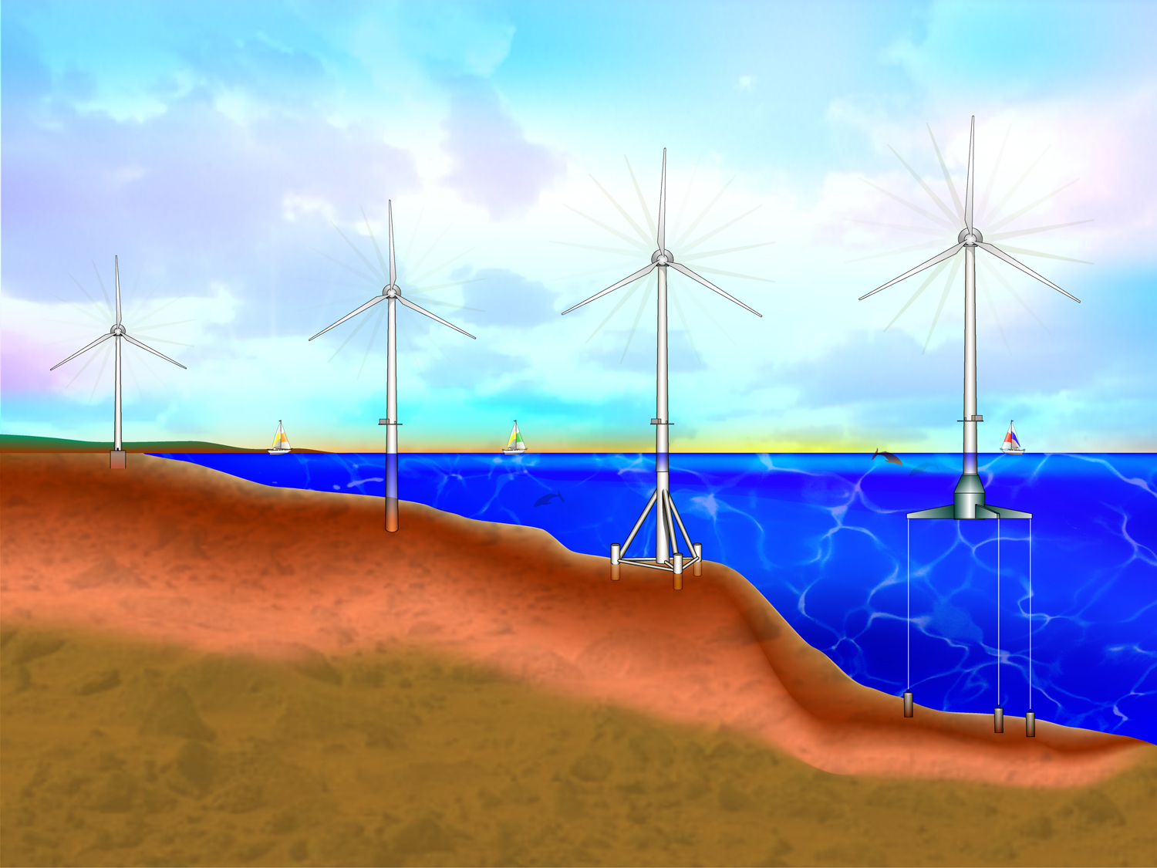
Land-based
Shallow Water
Transitional Depth
Deepwater Floating
Offshore Wind Technology
Commercially
Proven
Technology
Demonstration
Phase
Proof of Concept
Phase
Estimated
US Resource
0m-30m
430-GW
30m-60m
541-GW
60m-900m
1533-GW
No exclusions assumed for resource estimates
Notes:
9
Shows Technology advancements for greater water depths
The step to commercial projects transitional depths is likely to happen in the next five years
Deep water floating systems will take significantly more technology development and more time to develop.
Payoff in expanded resource

Slide 10
One Major Problem
MSP By Definition Is A Spatial Exercise
The Fishery Data Is Not At An Appropriate Scale or Form

Slide 11
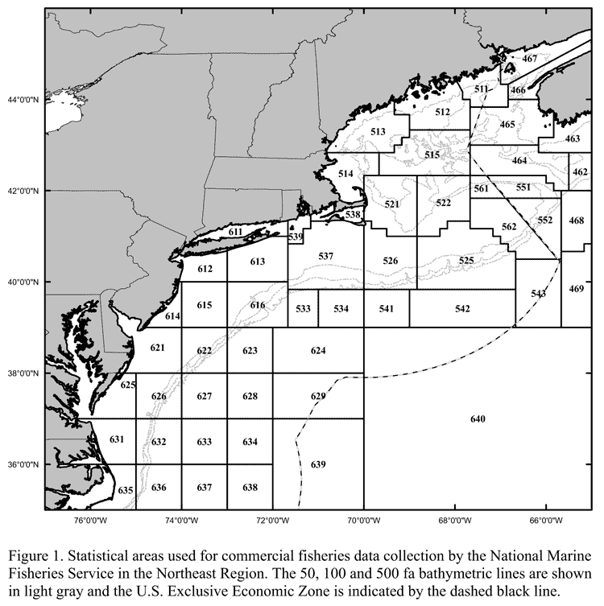

Slide 12
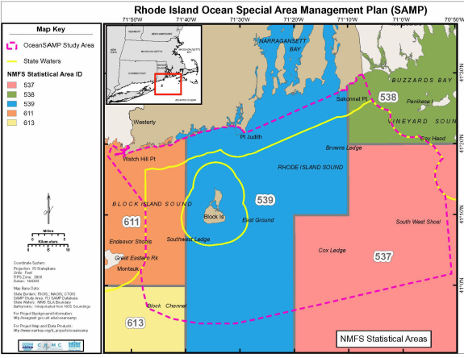

Slide 13
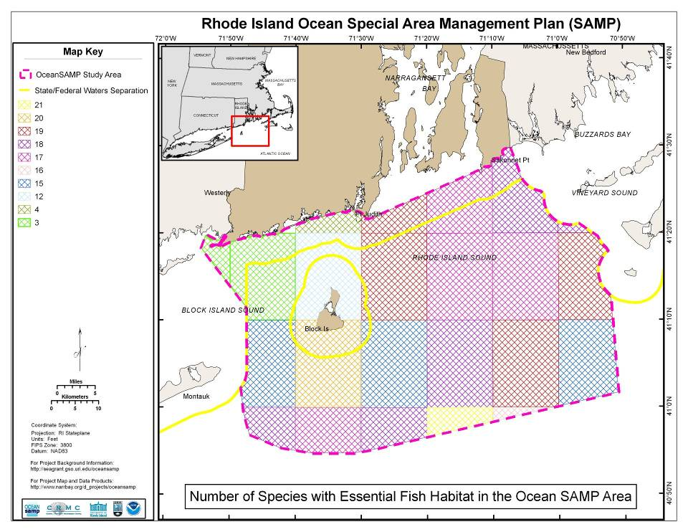
Number of Species with Essential Fish Habitat
Map created by RI DEM Division of Fish and Wildlife
Notes:
We had some help with Essential Fish Habitat mapping from our colleagues at DEM Fish and Wildlife. “Essential Fish Habitat” is designated under the Magnuson-Stevens Act for federally-managed species. It is a regulatory designation that indicates what areas are important habitat for certain species.
What this map shows you is the number of species, per 10-nautical-mile block, that have designated EFH w/in that area.
To be clear, this map, and EFH data, does not tell us anything about what type of habitat is actually there. It doesn’t show whether there is sand or gravel – so it’s not actually a habitat map. Instead, it shows areas that are important to certain species. Note that this is pretty coarse – doesn’t show a lot of usual detail – but is very important for regulatory purposes and needs to be considered by developers siting future projects.

Slide 14
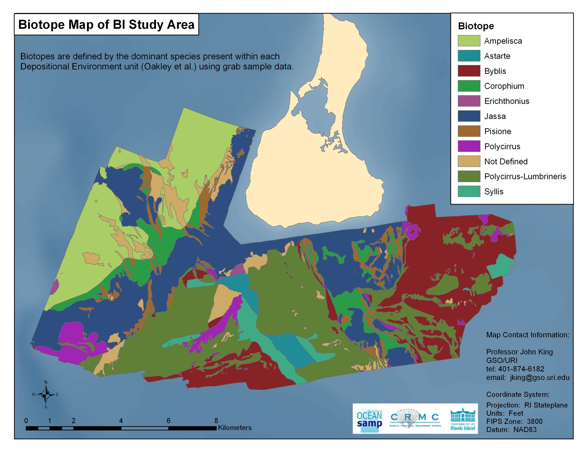

Slide 15
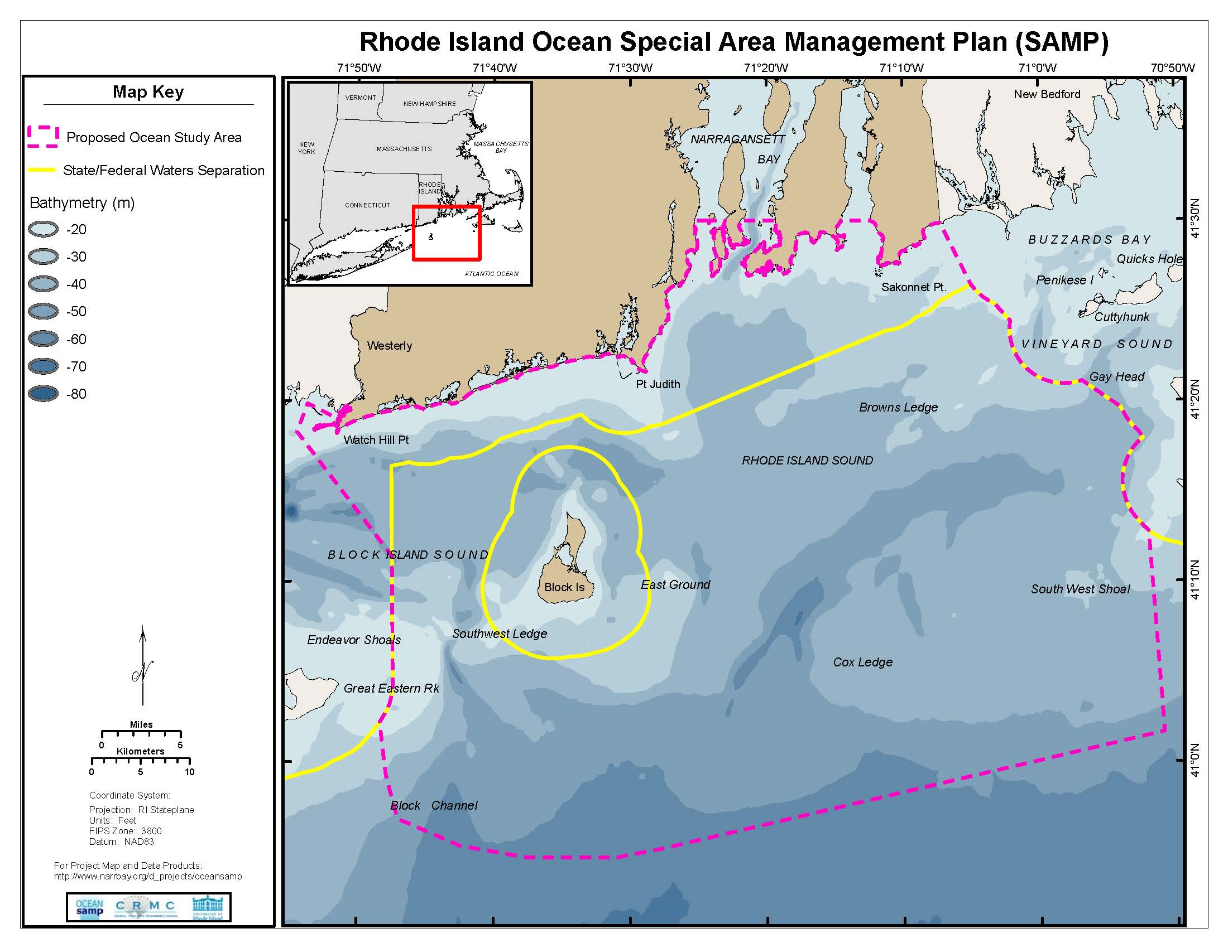

Slide 16
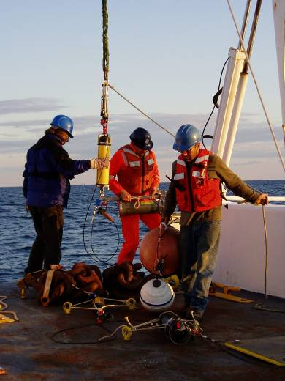
SAMP Research
Research Topics Include...
Wind resources
Marine mammals and birds
Fisheries uses
Physical oceanography
Ecosystem interactions
Sediment and benthic habitat
Cultural resources
Acoustics and electromagnetic effects
Meteorology
Engineering
Marine transportation uses

Slide 17
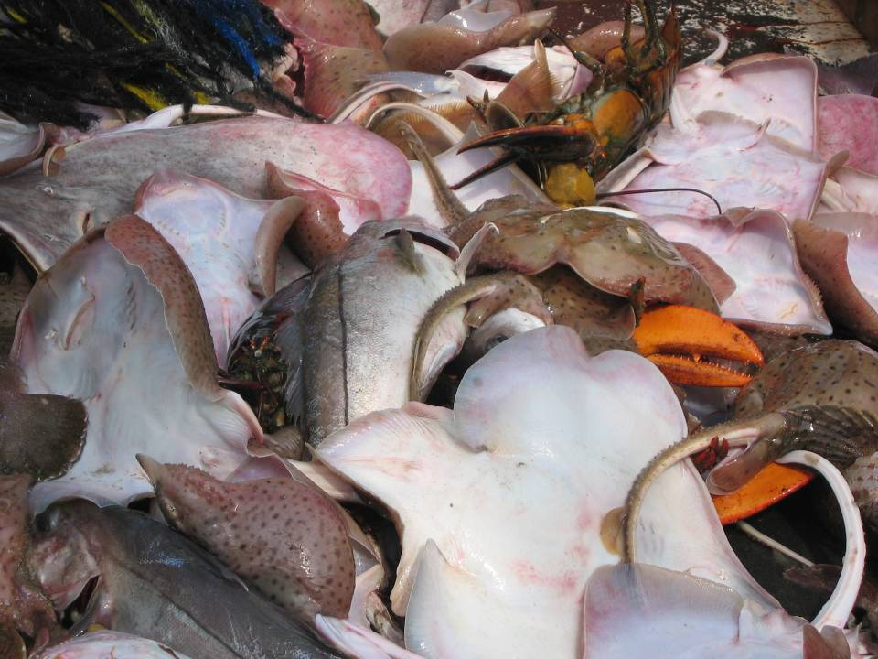
The Ocean SAMP Approach to Fisheries
Ocean SAMP Objectives:
To manage ocean space
In this space, manage existing resources and uses within the context of potential future uses
Summarize the best available data and information on resources/uses in the SAMP area
Address the issues and concerns of stakeholders and users to the extent possible
Notes:
The purpose of the Ocean SAMP is to manage ocean space. It is NOT to do fisheries management. There is already a multi-layered system in place to manage commercial and recreational fisheries in state and federal waters, and this is what our colleagues at DEM and the National Marine Fisheries Service do.
As our purpose is to manage ocean space, we need to manage existing resources/uses within that space within the context of potential future uses. As you all know, the Ocean SAMP is addressing the possibility of offshore renewable energy – which you’ll hear about in tonight’s second presentation – as well as other future uses.
In order to address the wide range of potential future uses in this region, we’ve attempted to summarize the best available data/information on resources and uses w/in the area.
We’ve also worked to address the issues and concerns of stakeholders and users.

Slide 18
Fisheries TAC
Atlantic States Marine Fisheries Commission
New England Fishery Management Council
NMFS Northeast Regional Office
RI Department of Environmental Mgmt.
RI Sea Grant Fisheries
Save the Bay
Conservation Law Foundation
The Nature Conservancy
Commercial Fisheries Research Foundation
URI GSO
RI Lobstermen’s Assn.
RI Commercial Fishermen’s Assn.
RI Fishermen’s Alliance
RI Party and Charter Boat Assn.
RI Saltwater Anglers Assn.
RI Monkfishermen’s Assn.
Ocean State Aquaculture Assn.
Ocean State Fishermen’s Assn.
Sakonnet Point Fishermen’s Assn.
Eastern NE Scalloper’s Assn.

Slide 19
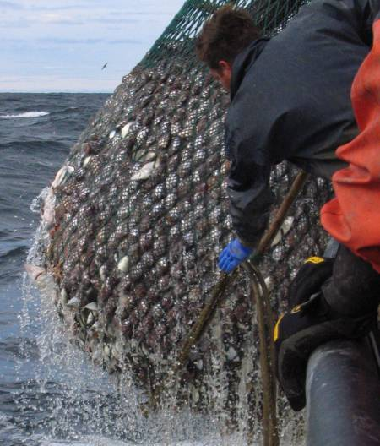
Fisheries Chapter Objectives
Provide baseline data and information on:
fisheries resources
commercial and recreational fisheries activities
Highlight the economic, social and cultural importance of fisheries
Outline policies and standards to protect and promote fisheries resources and activities
Notes:
Emphasize here – this chapter is about fisheries – that is, the human act of pursuing fish, whether for business or for pleasure. These objectives are shaped by that fundamental focus. Of course, fish are part of the ecosystem – and the ecology chapter includes a great deal of information about the ecosystem in which these fish live.

Slide 20
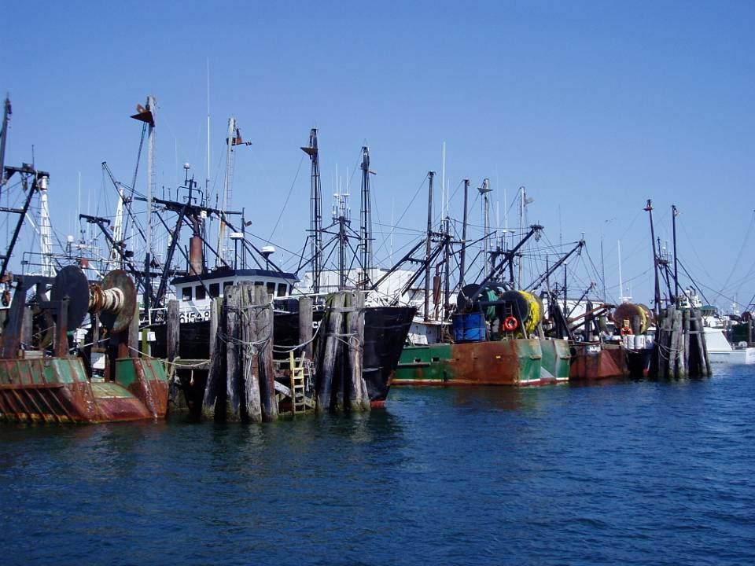
Chapter Methodology
Stakeholder and federal/ state agency input
Review of other “reference” documents
Literature and data review
Data analysis and mapping
Baseline characterization
Fisheries activity mapping
Notes:
From the start, we ASKED for input from fisheries stakeholders and other agencies incl NMFS and DEM.
First, we looked back at past SAMP documents to decide what information to include. However, because this particular SAMP is focused offshore and addresses the possibility of offshore construction, we also looked at other documents, such as Environmental Impact Statements from projects like Cape Wind. We also looked at the Minerals Management Services’ regulatory program for offshore wind.
We conducted our own literature and data search to find the best available data and information to include in the chapter.
Finally, we analyzed and mapped much of this data to produce maps and other things you see in this chapter.

Slide 21
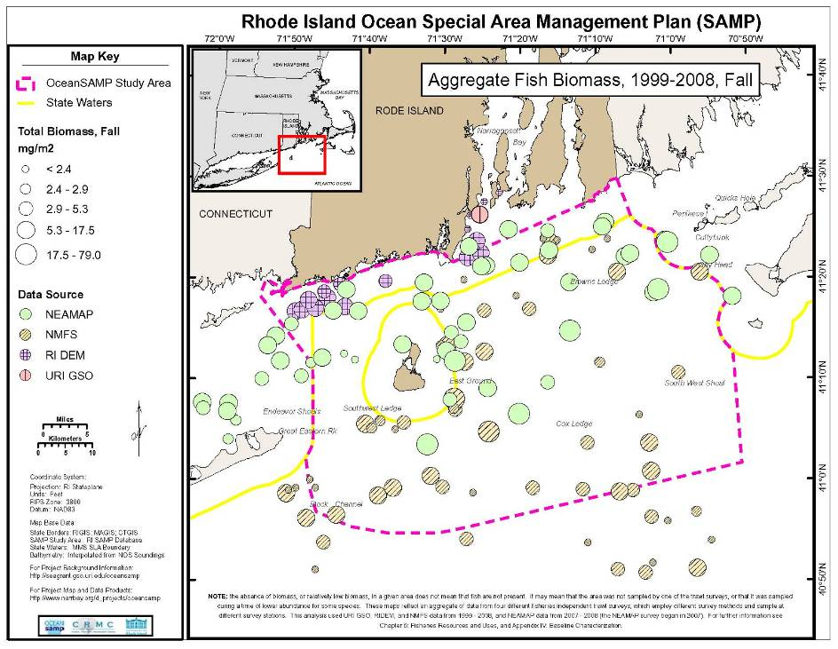
AGGREGATE FISH BIOMASS, FALL

Slide 22
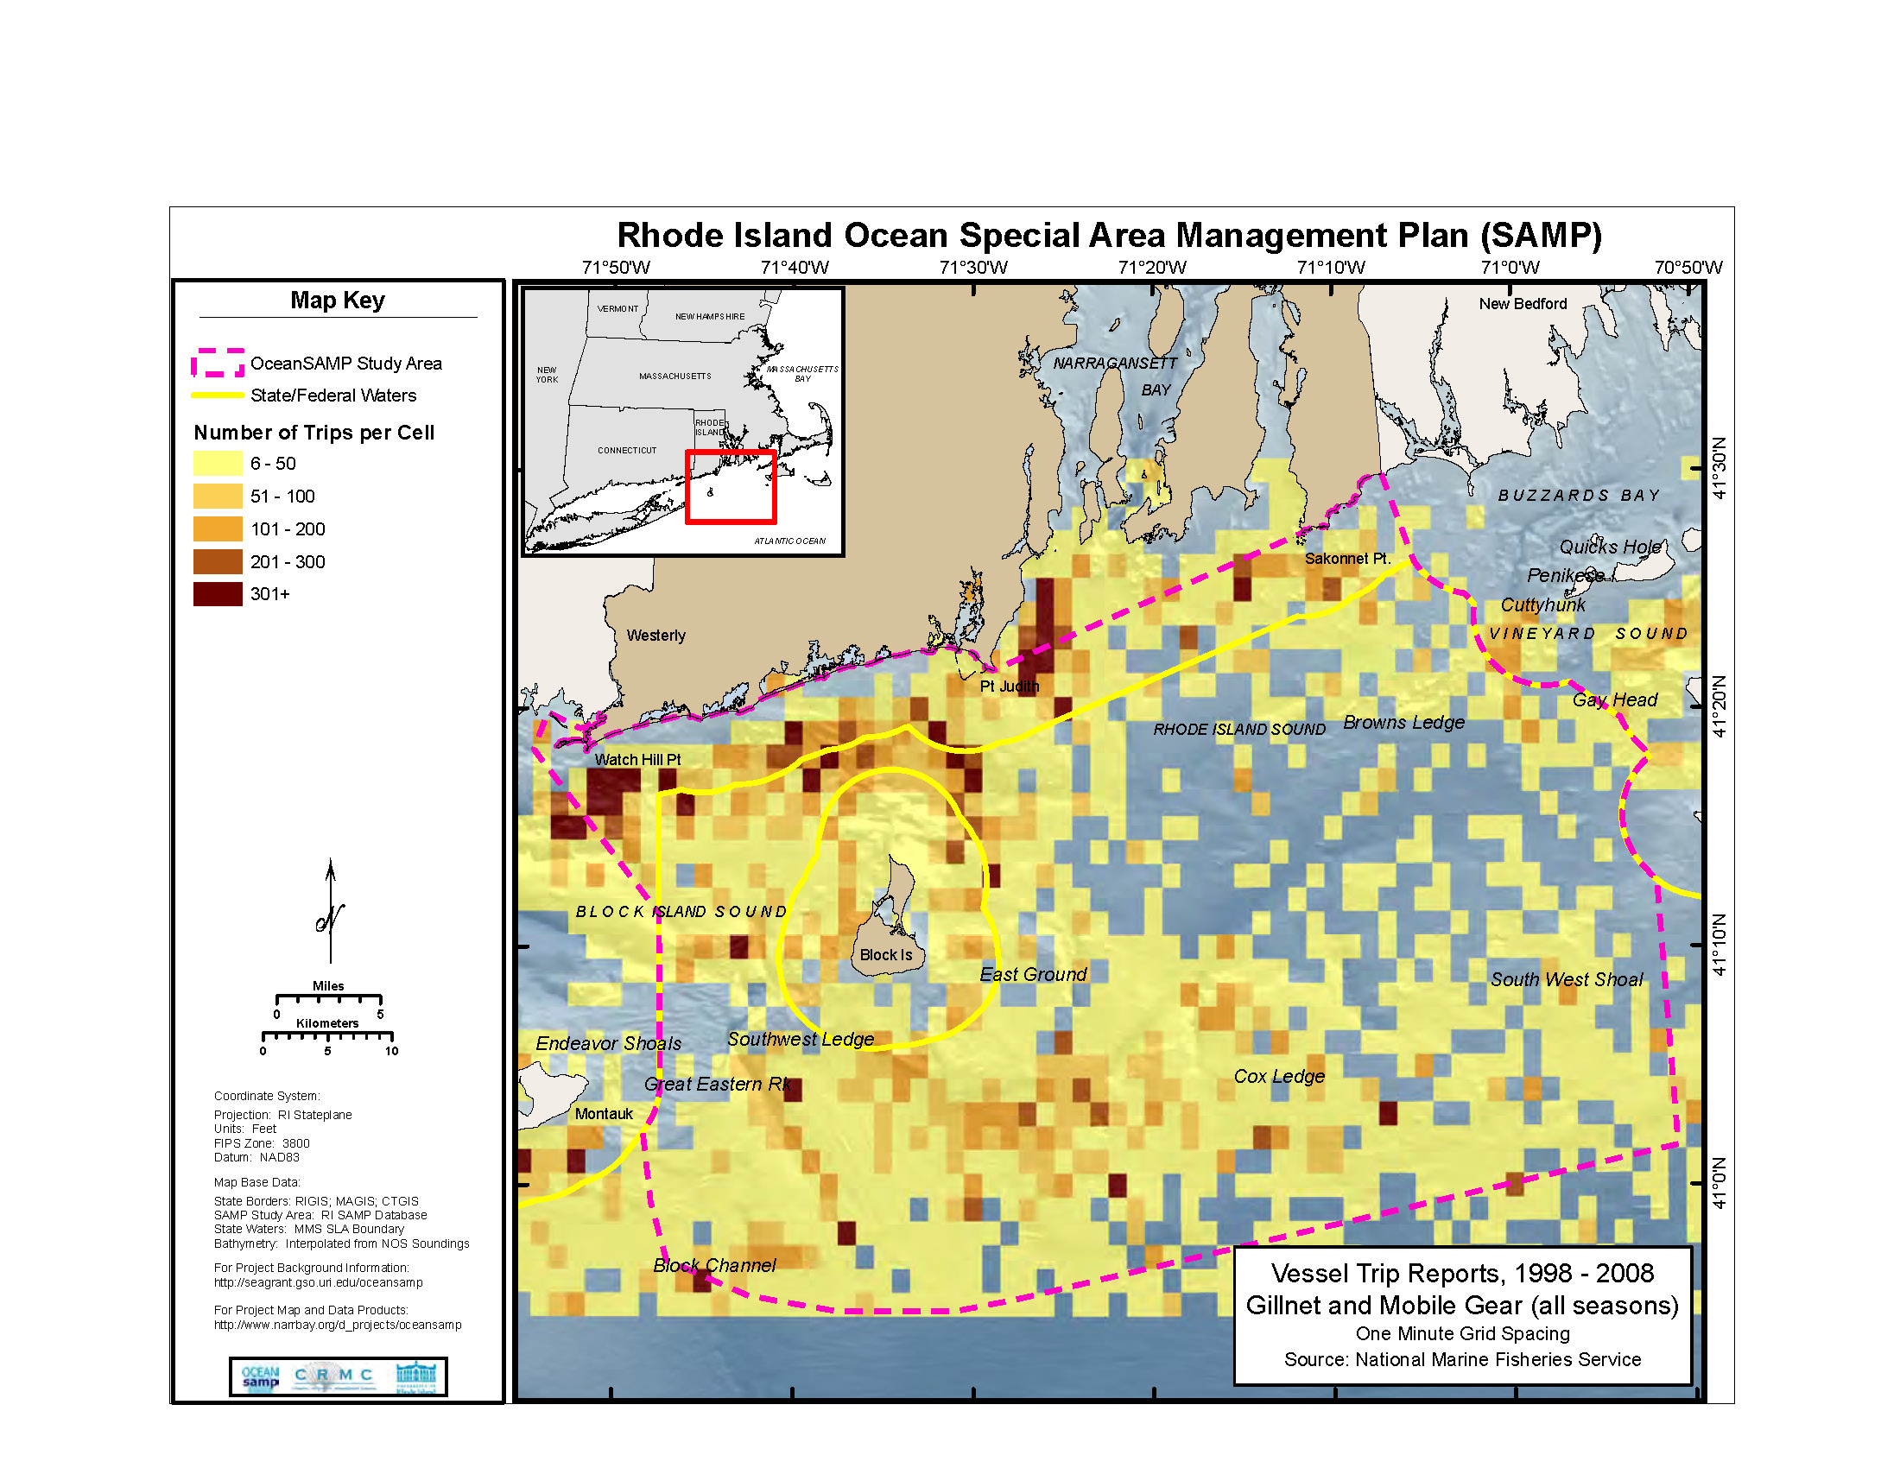

Slide 23
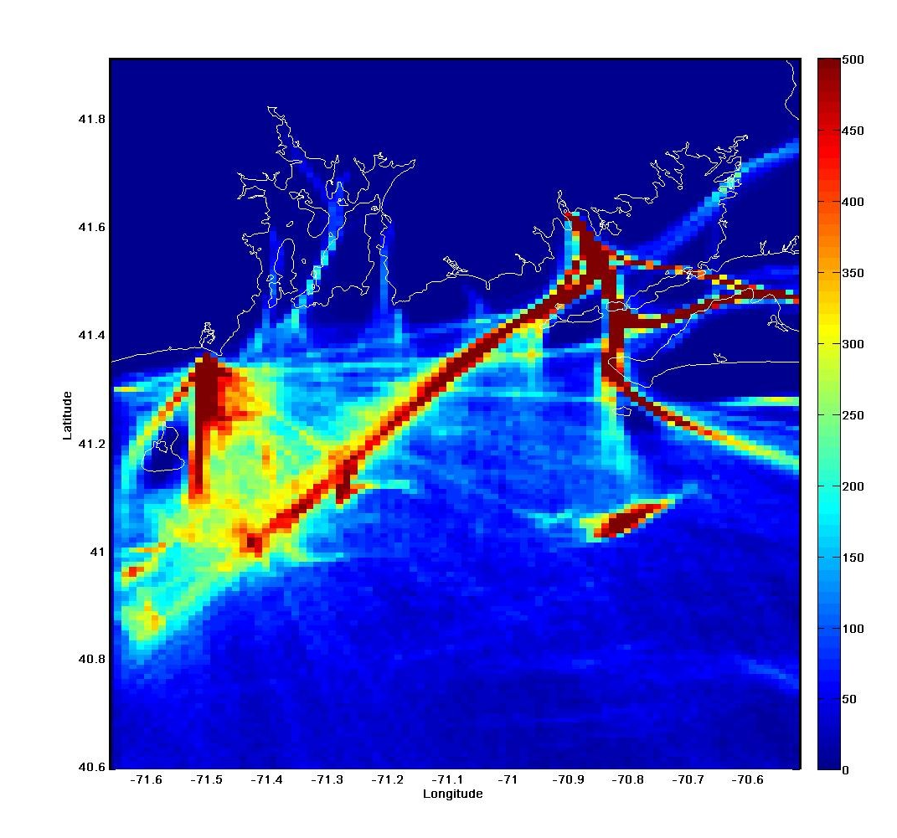
VMS Data
Notes:
23

Slide 24
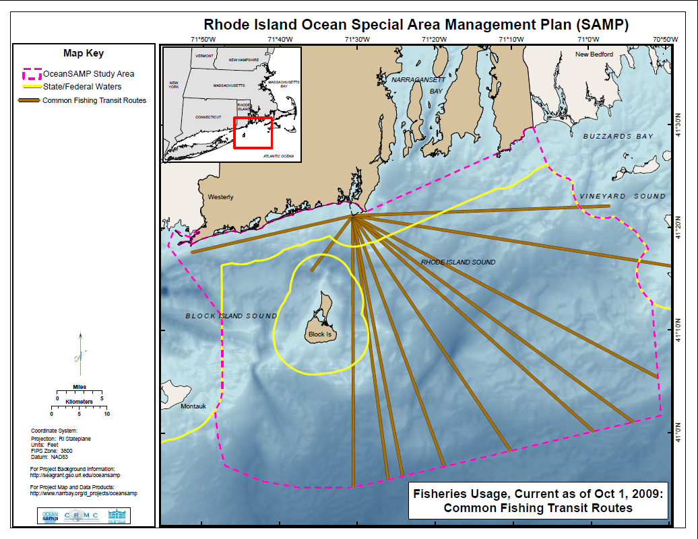

Slide 25
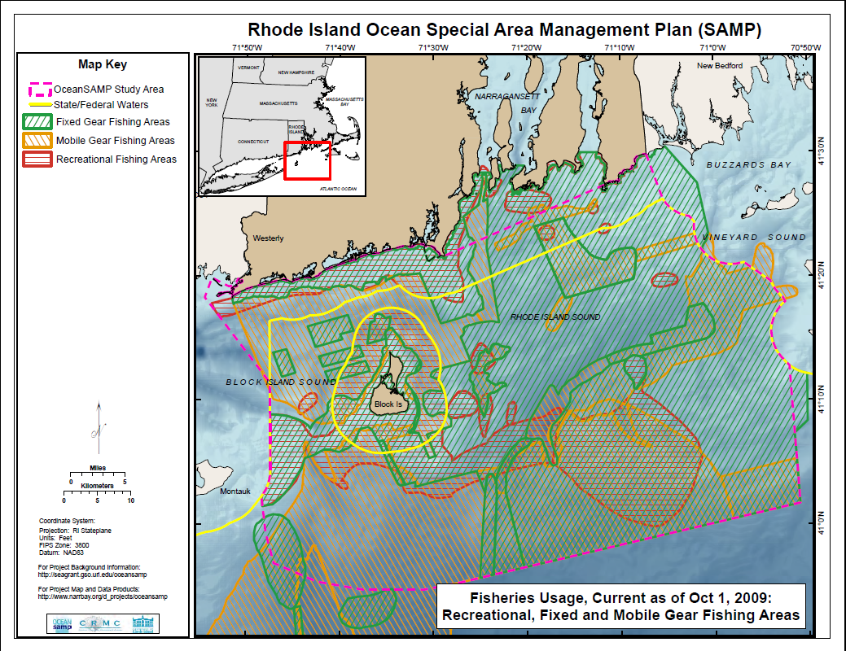

Slide 26
Why Not Map The Important Areas to Fishermen?
All Area Are Important
Fish Populations are Dynamic And Are On The Move Due To Climate Change
Markets Are Dynamic
Regulations Constantly Change The Game

Slide 27
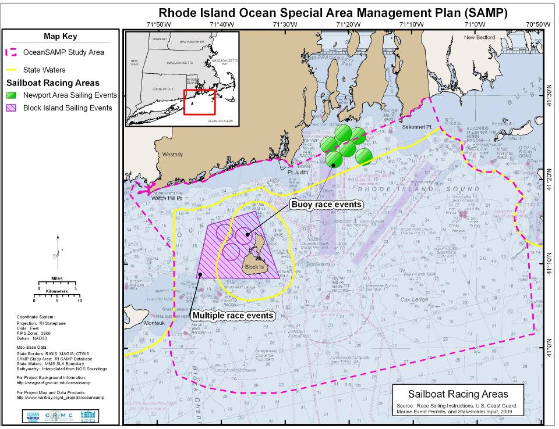
Notes:
27
Sailboat racing can be divided into two different categories – buoy races and distance races. Buoy races take place within a given area – race organizers set out buoys on the day of the race, depending on the wind/weather conditions – and racers race around those buoys – which may be arranged in a line, or a triangle, or something like that. Buoy racing events include Block Island Race Week, and numerous different races organized by Newport-based organizations like the New York Yacht Club, Sail Newport, and other clubs. We discuss 6 different regular buoy races in the chapter but there are many more than that.
This map was created through review of official race Sailing Instructions, USCG marine event permits, and consultation with stakeholders

Slide 28
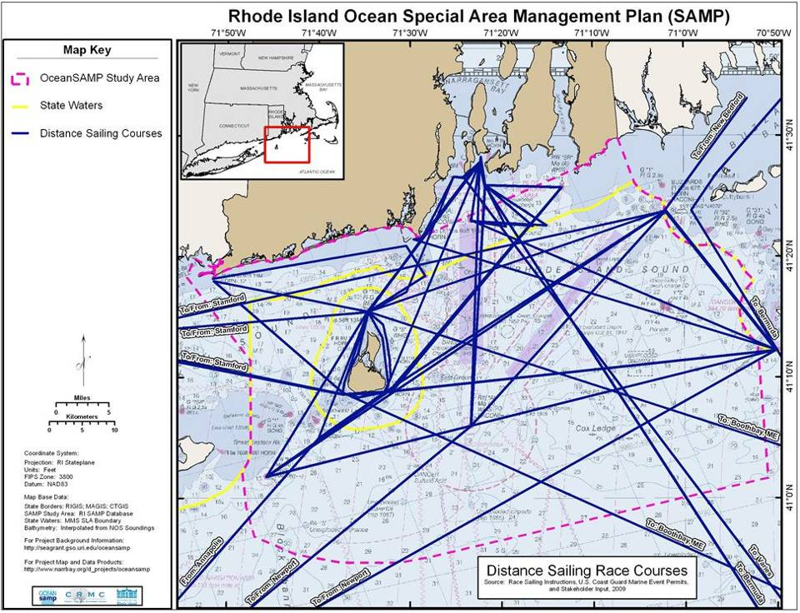
Notes:
28
This map represents 16 different distance races that take place in the SAMP area. Some start and end in Newport – NE Solo-Twin or Offshore 160; some start in Newport and end elsewhere – Newport Bermuda; others start elsewhere and end in Newport – Annapolis to Newport. Idea here is to simply represent the volume of activity that takes place offshore.
This map was created through review of official race Sailing Instructions, USCG marine event permits, and consultation with stakeholders

Slide 29
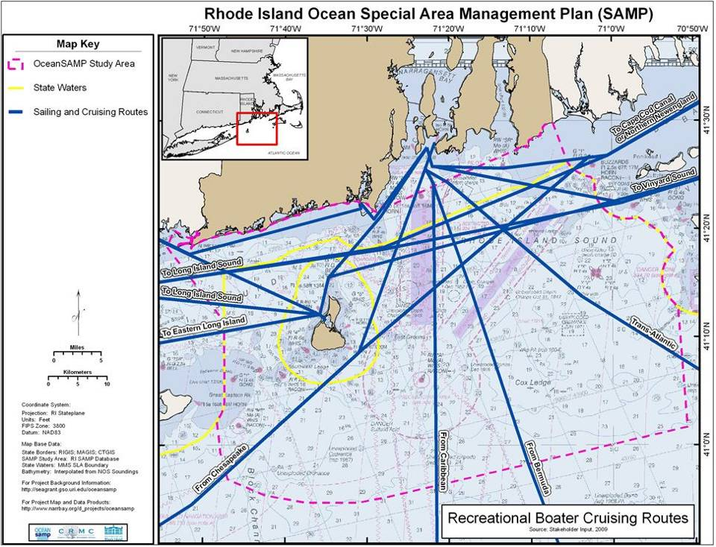
Notes:
29
As I mentioned before, recreational boating that takes place in the SAMP area – that isn’t fishing and isn’t
This map was created through stakeholder input.

Slide 30
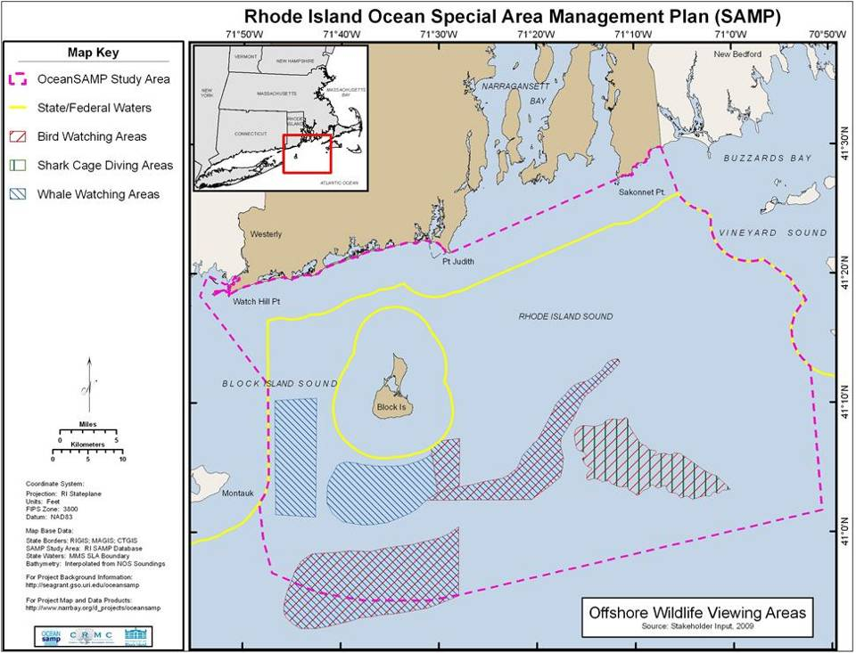
Notes:
30
The other charter boat activity offshore involve a few different types of trips that we group together as wildlife viewing. Basically, the purpose of your trip offshore is to observe – not to catch – wildlife. With the help of our stakeholders we learned that there are really three types of offshore wildlife viewing in this area: bird watching; whale watching; and shark cage diving. Bird and whale watching may sound self explanatory. For those of you unfamiliar with shark cage diving, this involves lowering a diver into the water, inside a cage, in an area where there are sharks, so that the diver can view the sharks.
Again this includes no shore-based such activities. This map was created through stakeholder input: interviews with charter boat captains.

Slide 31
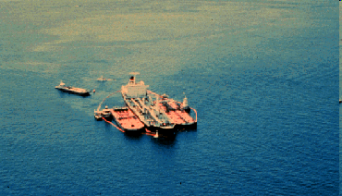
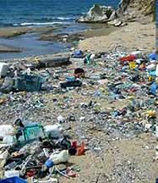
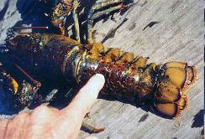
Impacts of Existing Activities and Trends on Fisheries Resources and Habitats
Fishing activities
Coastal development
Introduced species
Marine transportation
Dredged material disposal
Marine debris
Marine fisheries diseases
Global climate change

Slide 32
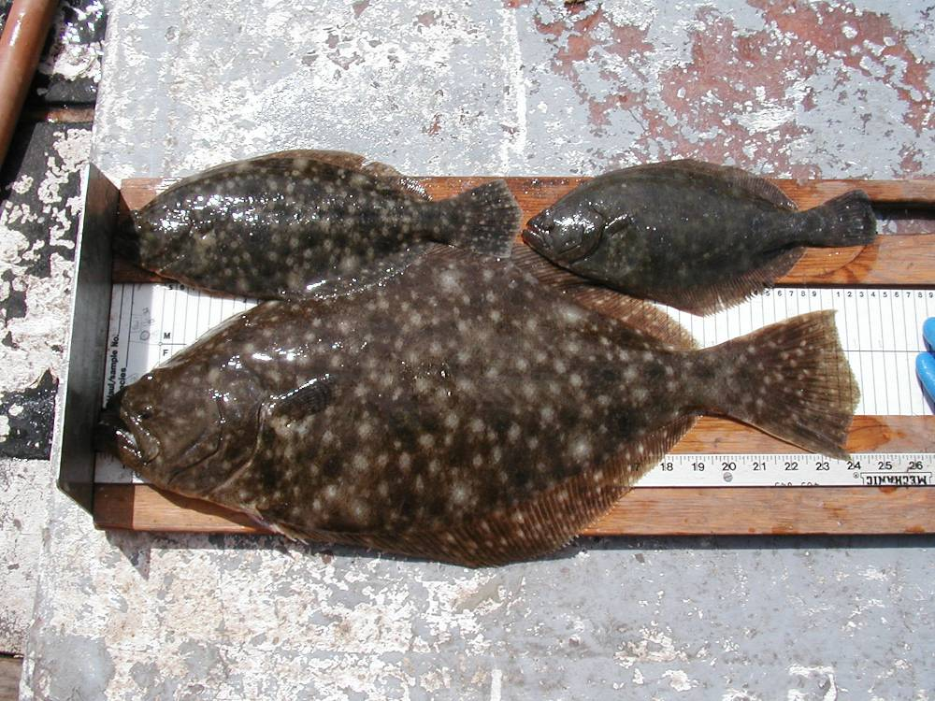
Policies and Standards
Value of commercial and recreational fisheries
Dynamic nature of fisheries
Important fish habitats and fishing areas
Offshore construction
Fishing access
Site-specific studies for future projects

Slide 33
Major Findings
Commercial and recreational fisheries are of great economic, social, and cultural value to the state of RI.
These activities are dependent upon key finfish, shellfish, and crustacean resources and the habitats upon which they rely.
Over the course of a year, the entire SAMP area is used by commercial and recreational fishermen.
Existing and future uses of the SAMP area may have an effect on fisheries resources and uses, and adverse effects must be mitigated to the extent possible through SAMP policies and standards.

Slide 34
560.2. Regulatory Standards
1. The Council shall appoint a standing Fishermen’s Advisory Board (FAB) which shall provide advice to the Council on the siting and construction of other uses in marine waters. The FAB is an advisory body to the Council that is not intended to supplant any existing authority of any other federal or state agency responsible for the management of fisheries. The FAB shall be comprised of six members, one representing each of the
following fisheries: bottom trawling; scallop dredging; gillnetting; lobstering; party and charter boat fishing; and recreational angling. FAB members shall serve four-year terms and will serve no more than two consecutive terms. The Council shall provide to the FAB a semi-annual status report on Ocean SAMP area fisheries-related issues, including but not limited to those of which the Council is cognizant in its planning and regulatory activities, and will notify the FAB in writing concerning any project in the Ocean SAMP area. The FAB shall meet not less than semi-annually and on an as-needed basis to provide the Council with advice on the potential adverse impacts of other uses on commercial and recreational fishermen and fisheries activities, and on issues including, but not limited to, the evaluation and planning of project locations, arrangements, and alternatives; access limitations; and measures to mitigate the potential impacts of such projects. Any Large-Scale Offshore Development, as defined in Section 1160.1 of Chapter 11, The Policies of the Ocean SAMP, will require a pre-application meeting with the FAB, the applicant, and the Council staff to discuss potential fishery-related impacts, such as, but not limited to, project location, construction schedules, alternative locations,and project minimization. During the pre-application meeting for a Large-Scale Offshore
Development, the FAB can also identify areas of high fishing activity or habitat edges.

Slide 35
2. The Council shall prohibit any other uses or activities that would result in significant long-term negative impacts to Rhode Island’s commercial or recreational fisheries. Long term impacts are defined as those that affect more than one or two seasons.
3. The Council shall require that the potential adverse impacts of Offshore Developments and other uses on commercial or recreational fisheries be evaluated, considered, and mitigated as described in section 560.2.4.

Slide 36
Areas of Particular Concern
Areas Designated For Presevation

Slide 37
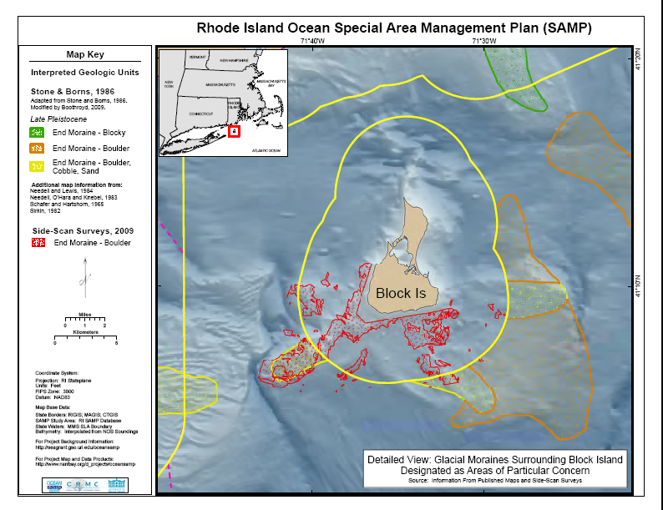

Slide 38
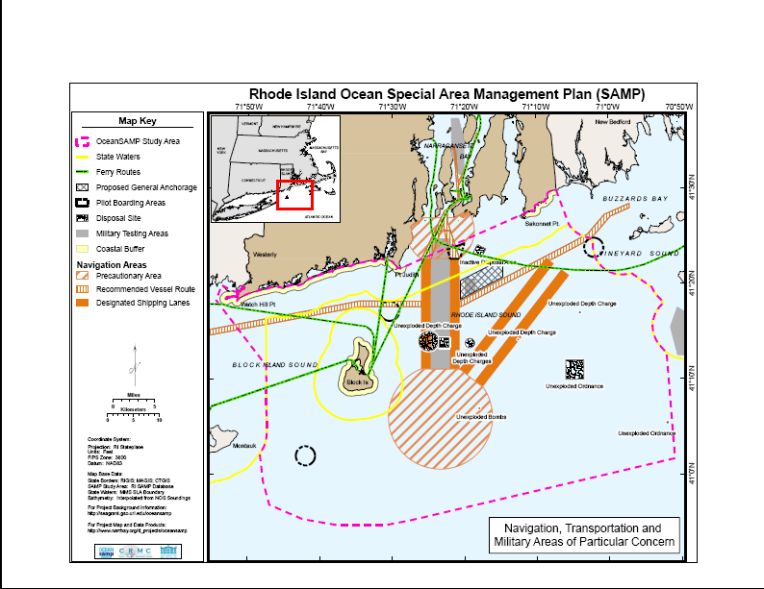

Slide 39
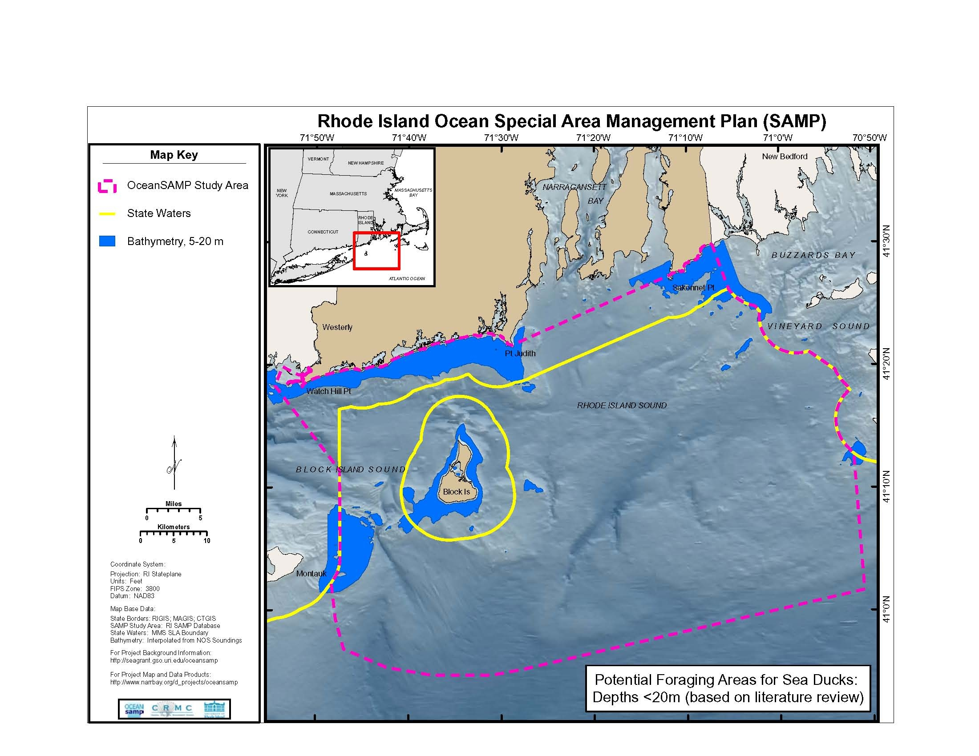

Slide 40
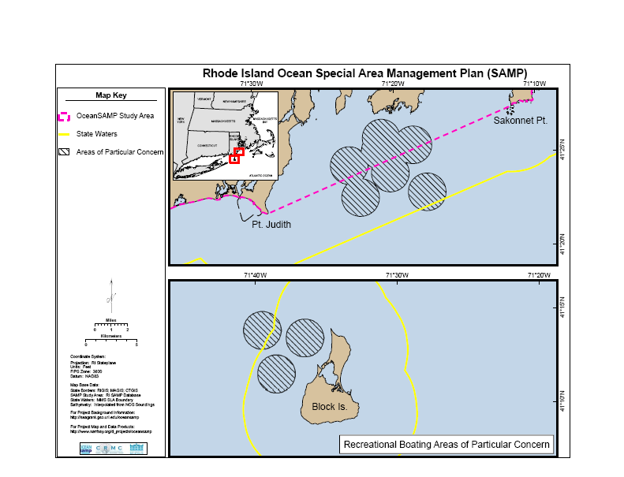

Slide 41
What Value Is MSP?

Slide 42
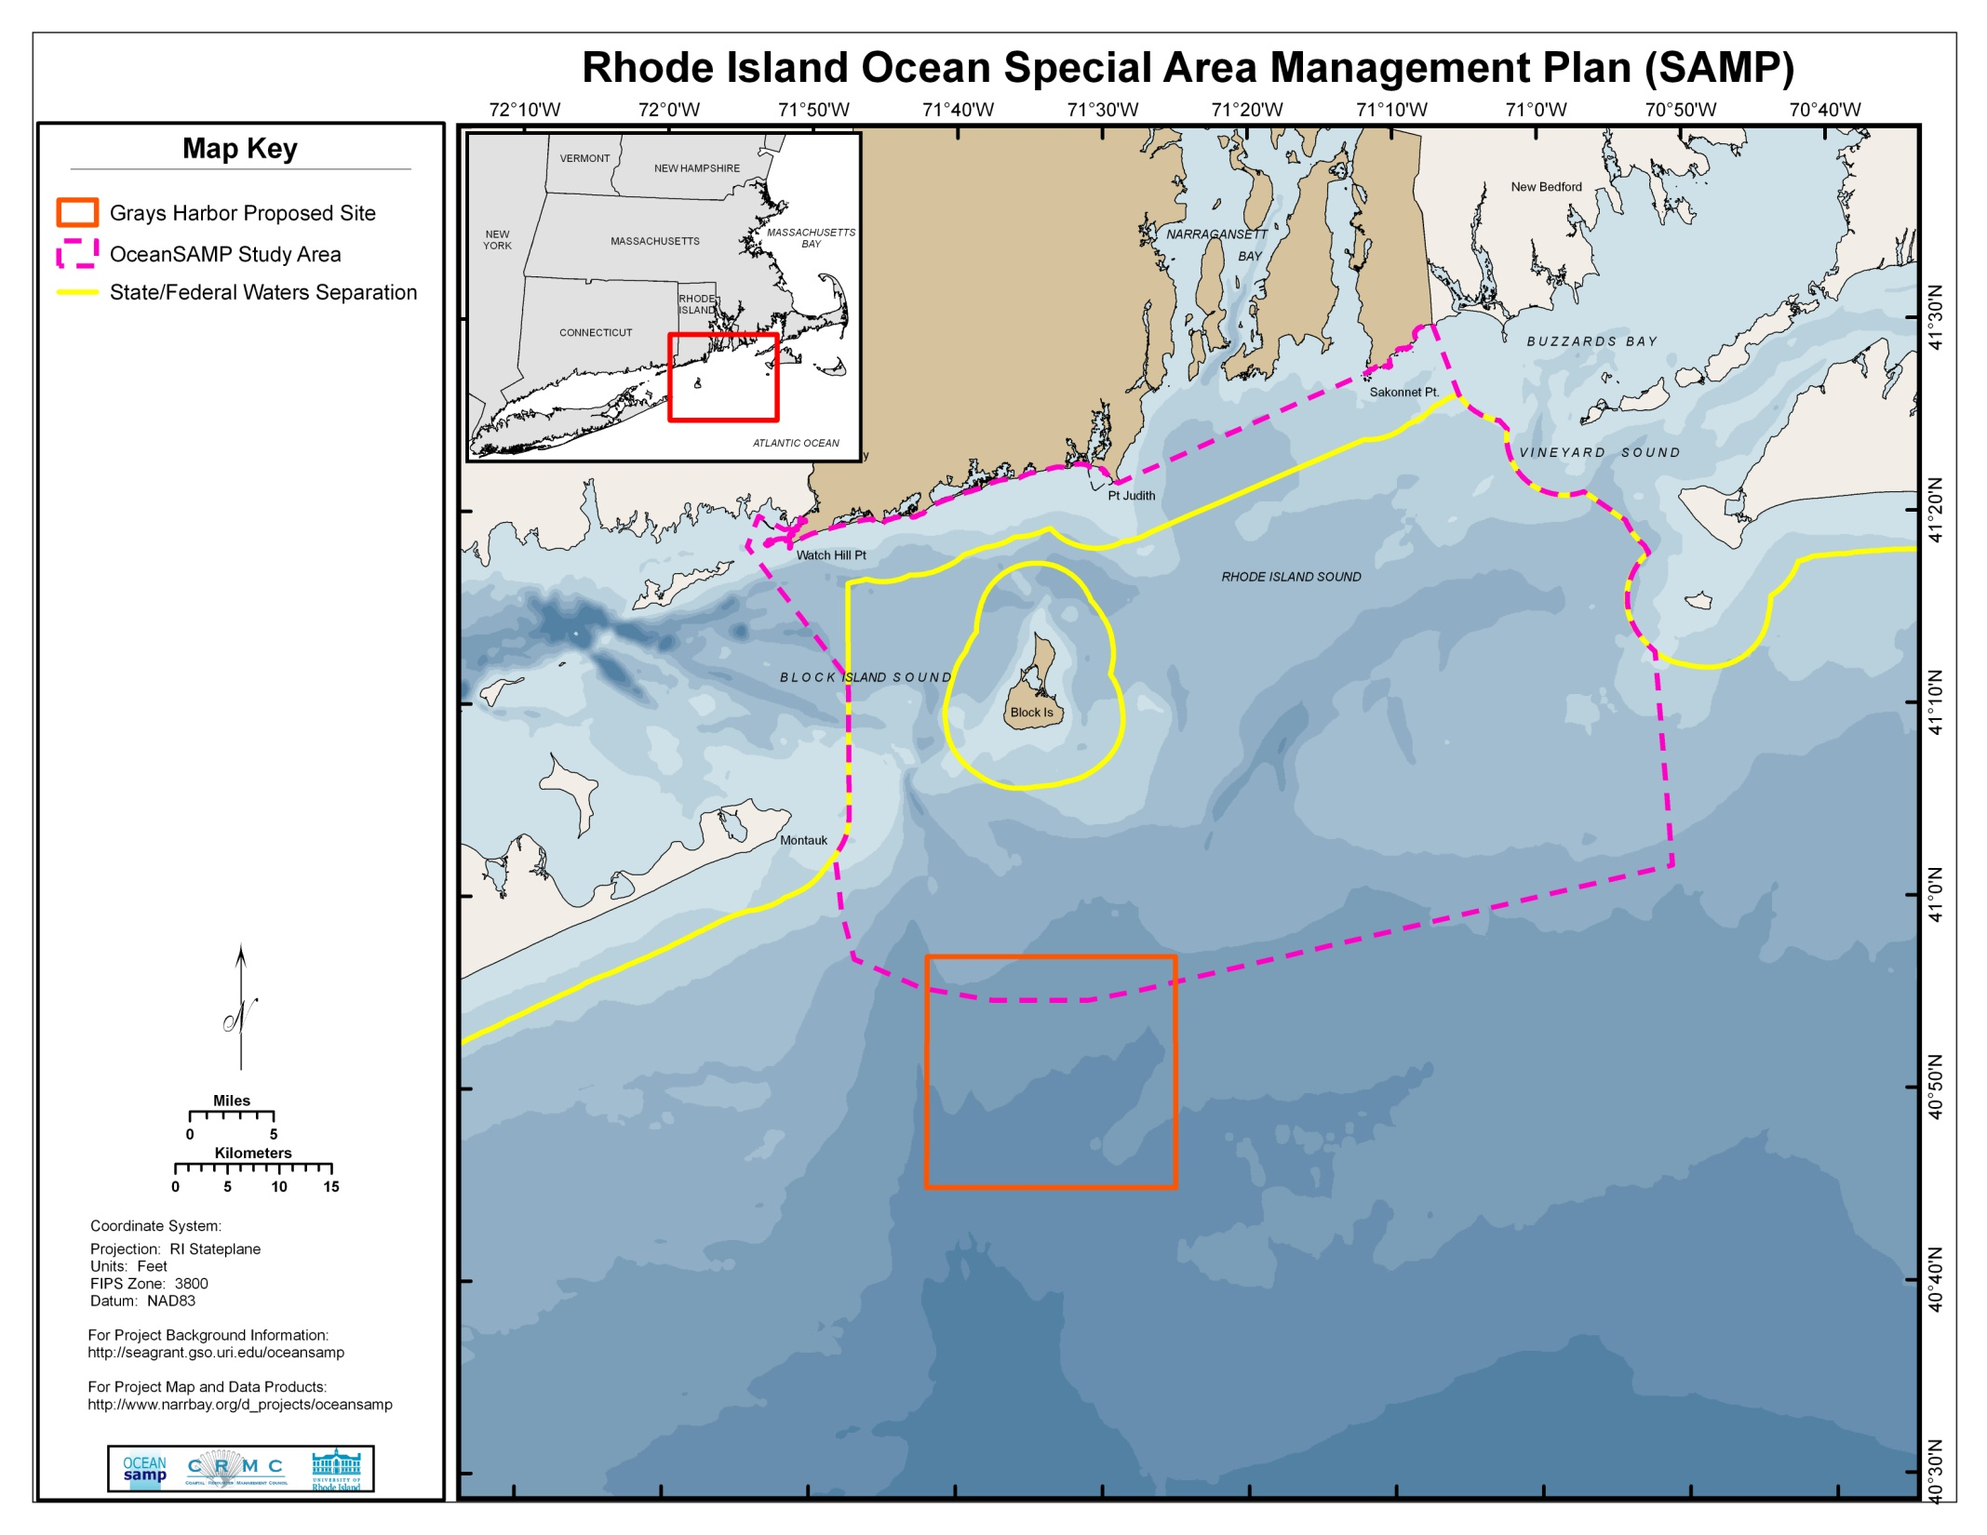
Notes:
42

